Slide 1
Sponsor Naming Conventions
Presenters
Susan Pease and BeBe McCoy
November 11, 2015

Slide 2
Office for Clinical Research Mission
The mission of the Office for Clinical Research (OCR) is to facilitate operational processes that support the efforts of the clinical research team in the timely initiation, management and completion of clinical trials at Emory.

Slide 3
Office for Clinical Research

Slide 4
OCR Pre-Award Divison
Responsible for research billing compliance and for the development of a prospective reimbursement analysis (PRA).
Develop and negotiate study budgets on behalf of Emory study teams for the purpose of initiating clinical research studies at Emory or at an Emory-affiliated institution.

Slide 5
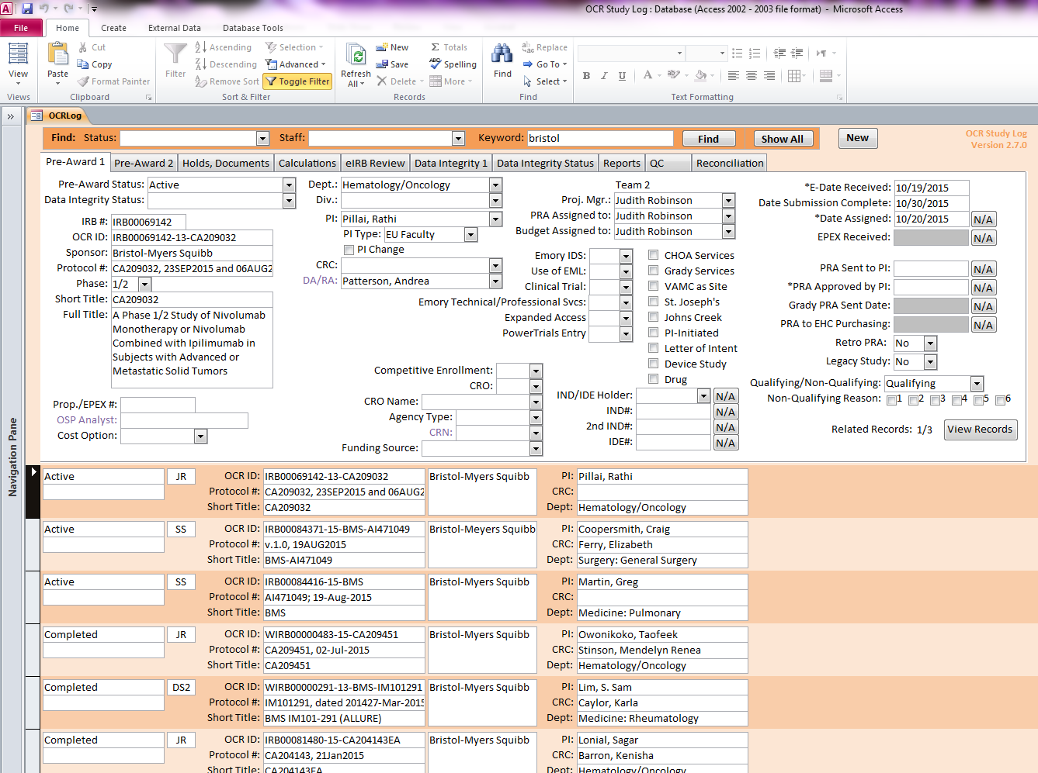
OCR Pre-Award Division
Pre-Award staff are part
of the beginning of the
process in OCR, and they
are responsible for the
majority of initial study
data information entry
into OCR’s respective
databases.

Slide 6
OCR Pre-Award Division
Consistency within the data fields are imperative for the purpose of data integrity.
An extremely important data field is the “Sponsor” of a clinical research study,
Indicates a federal vs non-federal funding source.
Allows improvements for data mining.
Improves budget negotiation processes.

Slide 7
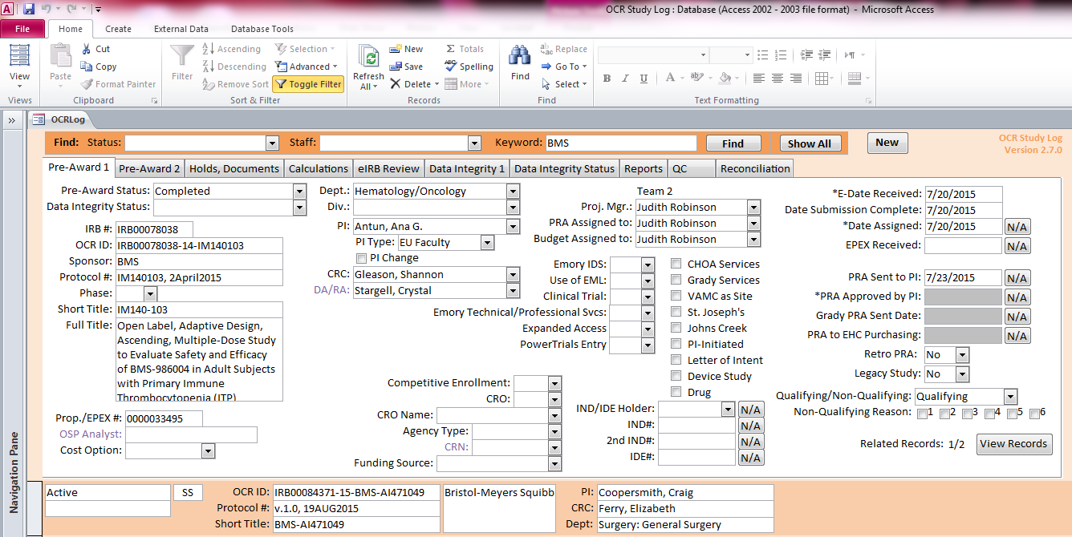
Examples of inconsistency
Bristol-Myers Squibb,
Bristol-Meyers Squibb,
Bristol-Myers-Squibb,
Bristol Myers Squibb,
BMS, etc.

Slide 8
Current (baseline) conditions

Slide 9
Goal: Aim statement
Streamline the process to reducing the inconsistencies and variations between the databases so the transition to OnBase will be effortless.
Improve the accuracy of the Sponsor Naming Conventions to 90% while reducing the inconsistencies and variations by 40% when entering the sponsor into the OCR databases by the end of FY 2015.

Slide 10
Problem analysis

Slide 11
Countermeasures
Action/Test of change | Outcome/what was learned?
Create Master Sponsor List for Pre-Award to copy/paste sponsor name into “Sponsor” field in database for all their active studies. | The countermeasure revealed: Standardizing the process disclose a significant improvement within a month of entering the Sponsor Naming Conventions in the databases. The test of change acknowledged a reduction with the inconsistencies and variations by 29%. The test was somewhat successful. The reason dealt with the lack of time after implementing the new process.

Slide 12
Pre-Award Process Adjustment
On September 23, 2015 we introduced to Pre-Award the new process:
-Utilize the “OCR OnBase Sponsor List” when naming the SPONSOR for all assigned active studies in the OCRLog.
This document was provided both in hard copy and electronic form and on the share drive for reference.
Whenever new sponsors needed to be added to the list an executive level of management must approve the addition.

Slide 13
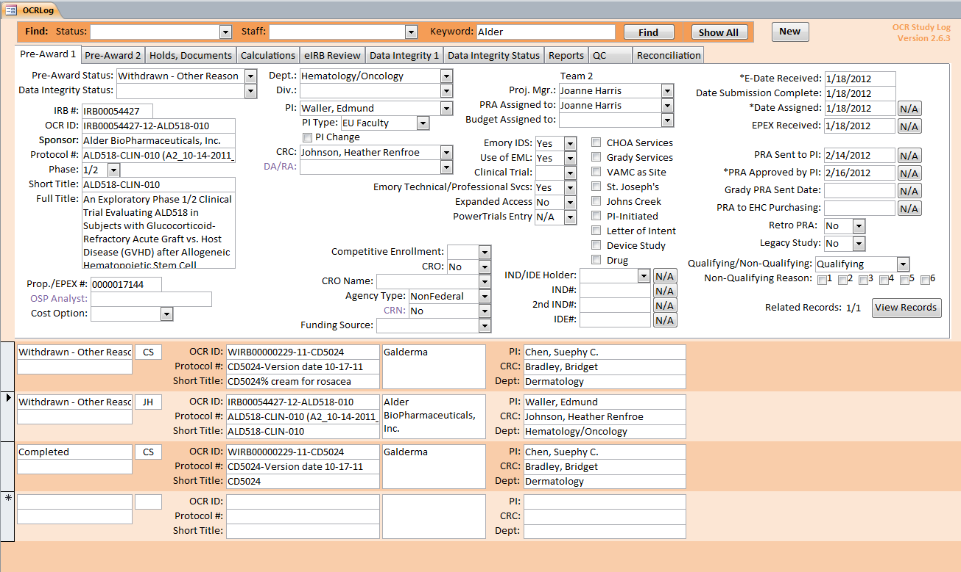
Pre-Award Process Adjustment
Copy
Paste

Slide 14
Metrics/results

Slide 15
Follow up/Next steps
The new process implemented in Pre-Award benefited the Data Intergrity Department within OCR, mainly because now it eliminates the discrepancies between the databases with the Sponsor Naming Conventions when activating studies in PowerTrials - POM.

Slide 16
Project scoring
Category | Points available | Criteria
Aim statement | 2 | How much, by when, on whom = 2, Two of these = 1
Metrics | 2 | Annotated data on run chart = 1 Use of >1 PI tools (flow, fishbone, etc.)= 1
Tests of change | 2 | One TOC = 1 > 1 TOC = 2
Reliability | 2 | Use of Reliability Design Strategy = 1 Use of human factors in design to achieve >90% reliability = 1
Effective use of tools | 2 | Used A3 format correctly = 1 Use of quantitative data to drive TOCs = 1

