Slide 1
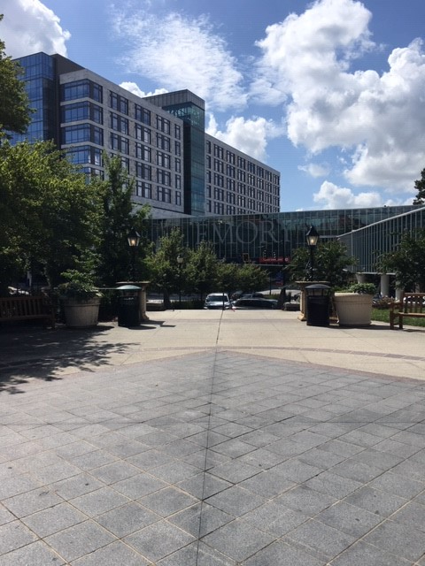

Slide 2
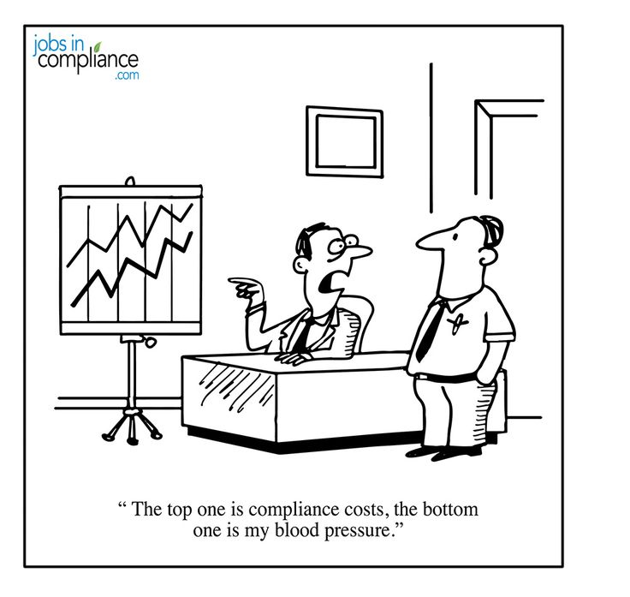
STANDIZATION and Streamlining of THE Office for Clinical Research (OCR) Prospective Reimbursement Analysis (PRA) grid
Cathy Cogan, BSN, MSc, PA-C, CHRC
and
Deborah Stout, MSN, NP-C, CHRC

Slide 3
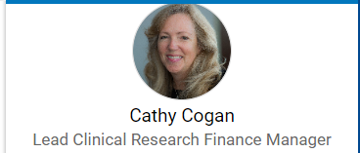
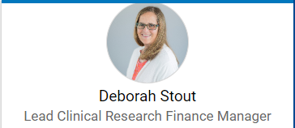
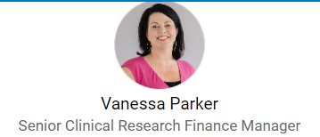
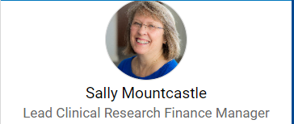
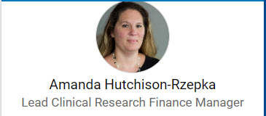

Slide 4
Background
Office for Clinical Research (OCR):
The OCR was established in 2001 as part of the School of Medicine’s strategic plan for research. It addressed patient safety as it revolved around regulatory compliance.
Per the Dean’s Mandate of June 11, 2007 – “SOM instituted a mandatory policy whereby any new clinical trial or other research study that requires any intervention with a human subject involving drugs, devices, services or procedures must have a Prospective Reimbursement Analysis (PRA) completed before the study would be approved by the Office of Sponsored Programs (OSP).”

Slide 5
Background
The Prospective Reimbursement Analysis (PRA):
The purpose of the PRA is to identify the appropriate payer for all billable items/services required in the clinical trial in order to ensure that charges are appropriately covered and to prevent billing errors.
Involves a thorough review of the protocol, draft Clinical Trial Agreement (CTA), draft budget, and draft informed consent document (ICD) in order to reach an objective determination regarding which items, services, etc. required of the protocol can and cannot be billed to third party payers using Medicare guidelines.
The PRA is uploaded into the billing system and can become part of the subjects medical record if they are a patient at Emory Healthcare.

Slide 6
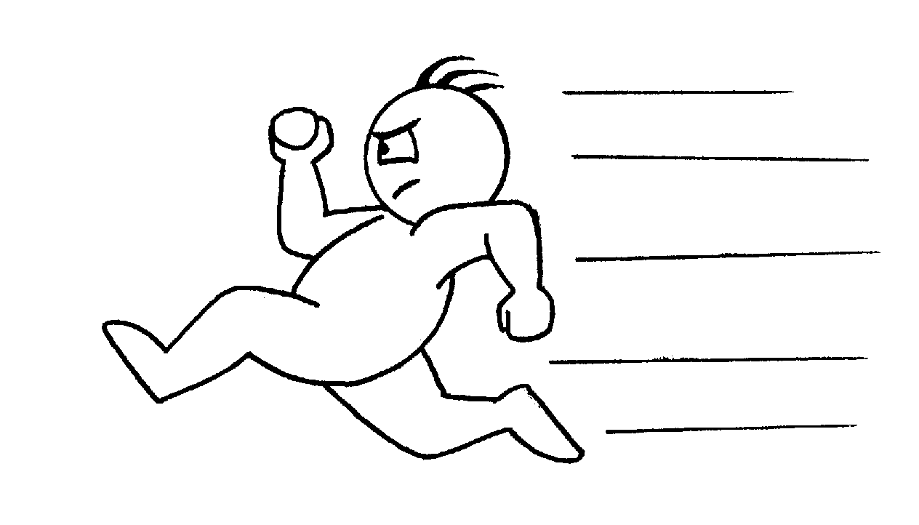
Goal: Aim statement
The goal of this project is to improve efficiency and lower personnel costs via process revision in which approximately 35 minutes of administrative work per study would shift to the protocol tracker, rather than by a lead clinician. The goal is to accomplish this by October 30, 2019
Secondary goals include improving uniformity of the PRA document by having specific fields completed by the same staff member (Protocol Tracker).
An additional goal is to increase customer and employee satisfaction by decreasing turn-around times.

Slide 7
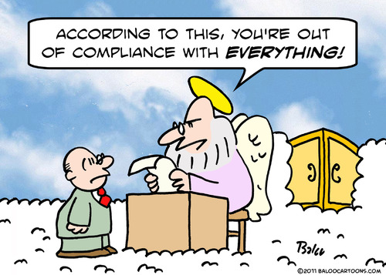
Current (baseline) conditions
There are an average of 44 research studies that arrive in the Office for Clinical Research in a month.
The studies are arrived/ processed by the Protocol Tracker and then assigned to a Lead Clinician.
Each Lead Clinician produces their own individualized PRA grid.
We wish to streamline and standardize the work flow process in creating a standardized PRA grid leading to greater efficiency thereby decreasing costs.

Slide 9
PRA Template
Proprietary and Confidential Completed by Emory University Office for Clinical Research |  |  | IRB00123456-19-TEST
 |  |  | A Multicenter, Double-Blind, Multidose, Placebo-Controlled Randomized Study of a Miracle Drug to Cure Every Illness
 |  |  | This Prospective Reimbursement Analysis (PRA) is intended as a general guideline for use in determining which items and services are billable to Medicare based upon current benefit policies, coverage determinations, and federal guidelines. All items and services that are billable to Medicare must be supported by medical necessity. This PRA was prepared by Emory University for its own internal business operations. As such, this PRA creates no rights or obligations as to any third party and Emory makes no warranties as to its accuracy. For budgeting purposes, with the exception of investigative devices, this PRA assumes that the Medicaid program and commercial insurers will cover at least as much as Medicare covers. Insurance policies vary, however, and there is no guarantee that a commercial insurer will cover or pay for all items/services designated on this PRA as billable to Medicare. Research subjects should be advised to contact their own insurance providers concerning their coverage.
Items & Services | Sect | CPT Code | Screening | Baseline | Visit 1 | Visit 2 | Visit 3 | Visit 4 | Comments
Physical Exam | 9.6 | 99215 | S | S | S | S |  |  | The Sponsor has agreed to cover the cost of this item/service.
ECG | 9.7 | 93000 | S |  | S |  |  |  | The Sponsor has agreed to cover the cost of this item/service.
CBC | 9.8 | 85025 | M |  | M |  |  |  | Per the National Coverage Determination (NCD) for Routine Costs in Clinical Trials (310.1), Items or services that are typically provided absent a clinical trial (e.g., conventional care are billable. CBC & CMP would be done at this time point per NNCCN guidelines. For…..
Comprehensive Metabolic Panel | 9.8 | 80053 | M |  | M
Brain MRI Without Contrast | 9.9 | N/A | S |  |  |  |  |  | The Sponsor has agreed to cover the cost of this item/service. Performed in CSI. No CPT codes generated for this item/service.
PI:
Prepared by:
Page 1 of 2 Pages
IRB000XXXXX-YY-ACRONYM_Draft/FINAL_PRA_MM.DD.YY

Slide 10
Sample PRA Template Page QUALIFYING CLINICAL TRIAL ANALYSIS
Protocol #: IRB00123456-19-TEST
PI: Hawkeye Pierce, MD
Dept: Surgery
Question | Yes | No | Supporting Information
Does the investigational item or service fall within a Medicare benefit category? | X |  | Drugs and Biologicals
Is the trial designed with therapeutic intent? | X |  | This purpose of this study is to determine if the administration of MIRACLEDRUG-006 is effective in resolving subdural hematoma.
Does the clinical research trial enroll patients with diagnosed disease? | X |  | This study enrolls subjects diagnosed with acute subdural hematoma.
Is the study deemed to meet the 7 desirable characteristics? | X |  | IND=123456
Is the study a Qualifying Clinical Trial? | X |  | The study meets the qualifying clinical trial criteria per NCD 310.1.
Documents used to complete PRA:
Protocol: MIRACLEDRUG-006-19; Ver 04; MAY 2019
ICF: Emory Draft Consent dated 26MAY2019 FDA IND Letter, dated 01APR2019 (April Fools)
CTA/Budget: VI Drug Co. Clinical Trial Agreement; not dated/Sponsor, budget not dated
Personal Communication with Study Team
PI: H Pierce, MD
Prepared by: dcs
IRB00123456-19-TEST_DRAFT_PRA_10.21.19
Page 2 of 2 Pages

Slide 11
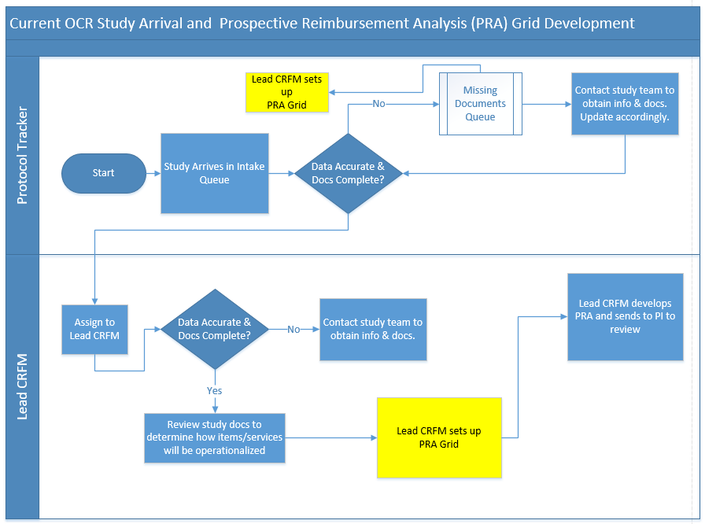
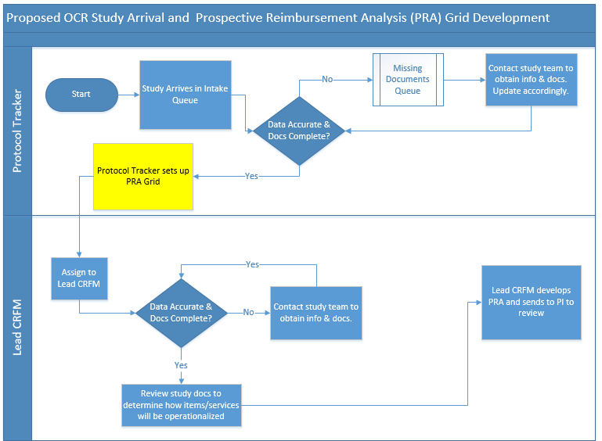
Current and Proposed Processes

Slide 12
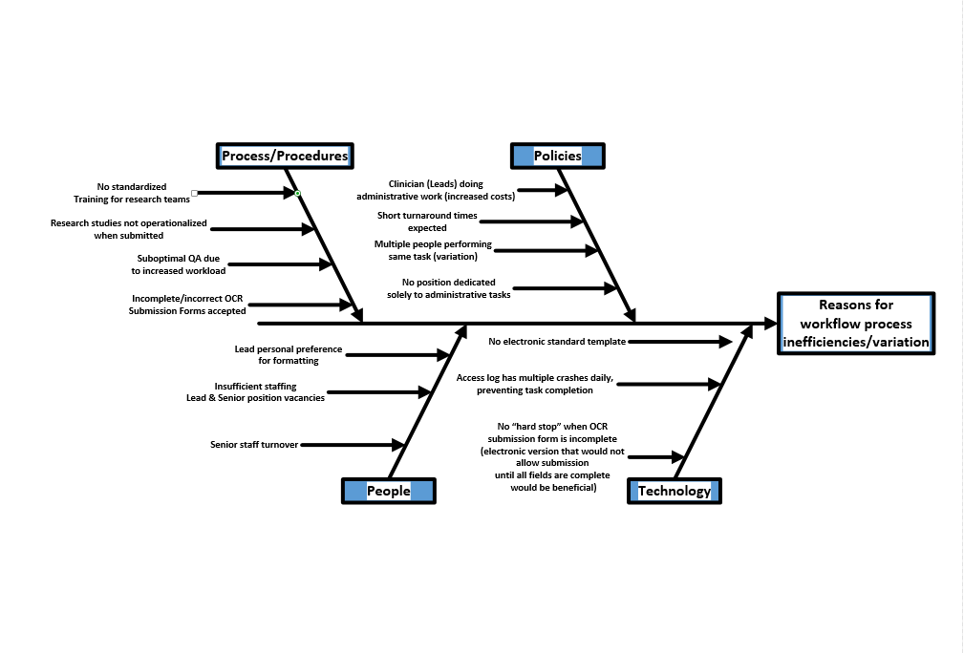
Insert fishbone here

Slide 14
Pre-Intervention Perceptions regarding change : Team 1 (n=5)

Slide 15
Countermeasures
Action/Test of change | Outcome/what was learned?
Changed to just Industry Sponsored Studies only (09.26.19) | Federal studies are structured differently, thus not amenable to new process. PI initiated studies are often too difficult in that there is no clear Schedule of Assessments.
Changed just to Team I only (10.01.19) | Oncology studies structured differently with multiple repeating cycles.
Modifications made to PRA grid based on feedback received from other staff members (10.16.19) | Multiple changes instituted to accommodate different types of studies. Learned that there are different approaches to the process used by individual leads.

Slide 16
Protocol Tracker Learning Curve: PRA Set up

Slide 17
Learning Curve: PRA Set up

Slide 18
Post-Intervention Perceptions regarding change : Team 1 (n=5)

Slide 19
Barriers
Barriers Encountered
Work volume very high leaving minimal time to devise, demonstrate, and implement the new process. | New staff hired and in training; additional new staff to be hired.
Different approaches to the process | Individualized process. Some worked on the studies while still incomplete “worked ahead” so their grid would already be set up when the standardized grid was presented. Some Leads opted to clone their grid from a past similar study.
Did not see “value added” in standardizing the process or the grid | Team 1 Leads have been in their positions for years (average of 8 years) and have their own personalized grids and didn’t want to switch or share. Metrics based on volume. This may be of value with new employees

Slide 21
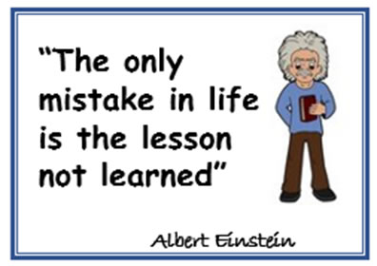
Lessons Learned
It’s all in the salesmanship. Universal buy-in is essential to succeed.
Consider making the template grid a voluntary process as we received some very valuable feedback that we could incorporate into the standardized grid and use going forward
Consider allowing Leads to submit their personalized grids to the Protocol Tracker if we move forward with piloting the process in the future
Protocol tracker became very efficient in a short amount of time so there is a benefit
A standardized process will reduce errors
Consider piloting new process with new hires

Slide 22
Follow up/Next steps
Continue to obtain feedback and incorporate feedback into grid changes.
Discuss process flow to determine best practice.
Re-evaluate if process change is realistic given the current staffing, or if the process change is creating a bottleneck.
If process change is successful, introduce to Team 2.
If process change is not successful, the revised grid will be available to staff on our shared drive.

