Slide 1

Research Matters
Office for Clinical Research
February 22, 2024

Slide 2

Seminar Recording

Slide 3


Seminar Facilitation
Be sure to MUTE during the seminar to avoid any background noise.
Place your CAMERA on so we can see you for engagement.
Please utilize the CHAT area to submit questions.
OR
Raise your HAND.

Slide 4




Accreditation Statement
The Emory University School of Medicine is accredited by the Accreditation Council for Continuing Medical Education (ACCME) to provide continuing medical education for physicians.
Credit Designation Statement
The Emory University School of Medicine designates this live activity for a maximum of 1.5 AMA PRA Category 1 Credits™. Physicians should claim only the credit commensurate with the extent of their participation in the activity.
Disclosure Statement
In accordance with the ACCME Standards for Integrity and Independence in Accredited Continuing Education, all relevant financial relationships, and the absence of relevant financial relationships, must be disclosed to the learners for all individuals in control of content:
Before the learners engage with the accredited education
In a format that can be verified at the time of accreditation
None of the planners or speakers for this educational activity have relevant financial relationship(s) to disclose with ineligible companies. Ineligible companies are those whose primary business is producing, marketing, selling, re-selling, or distributing healthcare products used by or on patients.
No grant support was received for this activity.

Slide 5
Agenda
11:30 am – 11:35 am Welcome & General Announcements
11:35 am – 12:05 pm Maternal Mortality and Social Challenges
Includes Q&A Shawana Moore, DNP, MSN, CRNP, WHNP-BC
Associate Professor
Emory University: Nell Hodgson Woodruff School of Nursing
12:05 pm – 12:35 pm Maternal Health, Mortality, and Research Studies
Includes Q&A Suchitra Chandrasekaran, MD
Associate Professor
Emory University School of Medicine: Gynecology & Obstetrics
12:35 pm – 1:00 pm Emory Healthcare EPIC Subject Timeline
Includes Q&A Bridget Strong-Benson, PhD(c), MBA, CRP
Director of Clinical Research Education & QI
Emory University: School of Medicine: Office for Clinical Research
Tiffany Hand Herring
EPIC Analyst II
Research at Emory Healthcare Inc., EHI Emory Digital
1:00 pm Closing Remarks

Slide 6
Seminar Objectives
To provide information on maternal health and mortality
To present obstetrics research studies
To provide information on social challenges of pregnancy in minority groups
To provide an update on the EPIC Timeline

Slide 7

Announcements
General Announcements

Slide 8




Slide 9
OCR Announcements
1 Clinical Research Finance Manager Position-OCR Invoicing
Emory University Careers
ELMS→Brainier!
Learning Management Tile→Learning Management-Brainier OR Request Brainier LMS Access

Slide 10
TEXT ATTENDANCE
*FIRST TIME USERS ONLY!
Send a text to (833) 705-1500 with just your Email Address that is connected to your existing Online Profile. This will create an account and connect your responses to your profile. This is a one-time set-up. (Skip if you have already texted in a CME activity accredited by Emory School of Medicine).
ACTIVATED ACCOUNT!
Once you receive a reply that your account has been found, you can now begin using the Text Messaging service.
TO CLAIM CREDIT: (TIME SENSITIVE) COMPLETE WITHIN 7 BUSINESS DAYS
Text Attend 17863 to (833) 705-1500.
You will receive a “Reply Confirmation” with the Event Name upon successful completion of your response.
Your attendance will be immediately recorded and readily available. Go to https://med.emory.edu/education/cme/ to access your CME activity online profile and transcript history.
Questions? Email: cme@emory.edu
Emory Continuing Medical Education
phone: (404) 727-5695

Slide 11
CLAIM CREDIT ONLINE -
TO CLAIM CREDIT IN THE EMORY CME ONLINE PORTAL:
(TIME SENSITIVE) COMPLETE WITHIN 7 BUSINESS DAYS
Sign into the Emory CME Portal using your email and password, or create a new account: https://med.emory.edu/education/cme/
You will receive a message that sign in is successful.
Select the tile “Claim Credit”.
Enter the session id 17863 (provided during the activity)
Upon successful completion of your response, you will be directed to the page to claim credit and download your CME certificate.
Your attendance will be immediately recorded and readily available in your CME transcript. Go to https://med.emory.edu/education/cme/ to access your CME activity profile and transcript history.
Questions? Email: cme@emory.edu
Emory Continuing Medical Education
phone: (404) 727-5695

Slide 12

MS VIVA ENGAGE
Launch Date
March 4, 2024
MS Viva Engage will replace the CRCDISCUSS Listserv.
It is a social layer where employees can dive deeper into communities, share their stories, engage with coworkers, attend virtual events, and find belonging at work.

Slide 13
TRAINING AND EDUCATION
The Bridge Course: OnCore and Epic
Monday, February 26, 2022 at 9:30 am
This course is designed to aid the research community in understanding the components required between OnCore and Epic, such as Calendar version changes, MRN ADT refresh, Billing Timelines, Orders, and Encounters.
This course is 2-3 hours via Zoom with real-life examples and scenarios. Learning engagement is a must with scenarios to work through solutions.
Register in Brainer at https://emory.brainer.com. Search for “Bridge.”
Clinical Research Orientation & Training
Managers/supervisors, please ensure new hires, rehires, or those recently promoted to attend Orientation. Orientation provides the team member with their training track and EHC credentialing tier.
OnCore is pending its latest upgrade. However, if you need a refresher, please contact OCR@Emory.edu. New training information is coming soon.
Guides and tips sheets can be found on OCR’s website or OnCore SharePoint site.

Slide 14


Slide 15


Maternal Mortality and Social Challenges
Shawana S. Moore, DNP, APRN, WHNP-BC, PNAP, FAAN
This Photo by Unknown Author is licensed under CC BY-NC-ND

Slide 16
Learning Objectives
At end of the session participants will be able to:
  Understand the factors contributing to maternal morality and its impact in Georgia.
  Identify the social challenges and potential solutions to address maternal mortality in Georgia.

Slide 17

Equity involves ensuring that all individuals have access to the same resources, opportunities, and outcomes.
(WHO, 2020)
Notes:
Equity refers to the concept of fairness and justice in the distribution of resources, opportunities, and outcomes. It emphasizes the need to address and eliminate systemic inequalities and ensure that everyone has an equal chance to thrive and succeed, regardless of their background or circumstances.
World Health Organization. (2020). Equity. Retrieved from https://www.who.int/healthsystems/topics/equity/en/

Slide 18
Equity in Maternal Health
Equity in obstetric care means that all birthing people receive access to the same quality of care, regardless of their race, ethnicity, socio-economic status, or other factors.
This includes access to prenatal care, safe and appropriate choices for delivery, and postpartum support.
Equity in obstetric care can lead to better health outcomes for birthing people and their babies.
(Edmonds & Fantasia, 2022)

Slide 19
Lack of Equity in Maternal Health
Marginalized communities often experiencing poorer outcomes.
In the United States, Black women are three to four times more likely to die from pregnancy-related causes than white women.
Other marginalized groups, including Indigenous women and women of color, also experience poorer outcomes and decreased access to care.
(Collier & Molina, 2019)

Slide 20
Populations Mostly Affected: Why it Matters
Black women are more likely to experience maternal morbidity and mortality compared to white women.
Indigenous women are also at a higher risk of adverse obstetric outcomes, such as preterm birth and infant mortality rates.
Low-income birthing people face barriers to accessing timely and quality obstetric care, which can further exacerbate health disparities.
(Taylor, 2020)

Slide 21

Problem Statement
The United States is currently facing a maternal health crisis that demands urgent attention. Despite being a highly developed country, the maternal mortality rate in the US is shockingly high compared to other developed nations. Pregnant individuals in the US face various challenges that contribute to this crisis, including limited access to quality healthcare, racial disparities, and a lack of comprehensive support systems. Many women lack adequate prenatal care, resulting in higher rates of complications during pregnancy and childbirth. Moreover, racial and ethnic minorities, particularly Black women, are disproportionately affected by maternal mortality, highlighting the issue of systemic inequalities in healthcare. To address this crisis, it is crucial for policymakers, healthcare providers, and communities to come together, improve access to quality prenatal and postnatal care, address racial disparities, and establish comprehensive support systems for expectant mothers. Only by prioritizing maternal health can we begin to combat this crisis and ensure the well-being of all women and babies in the United States.

Slide 22

U.S. Ranking for Maternal
This Photo by Unknown Author is licensed under CC BY-SA
Notes:
US continues to rank high for maternal mortality when compared to other developed countries.

Slide 23
Maternal Morality in the U.S. Highest
Louisiana 58.1%
Georgia 48.4%
Indiana 43.6%
(World Population Review, 2023)
Notes:
Studies have shown that women from racial and ethnic minority groups, individuals with lower socioeconomic status, and those living in rural areas are more likely to experience adverse outcomes during pregnancy and childbirth, such as preterm birth, maternal mortality, and infant mortality. These disparities are often attributed to inadequate access to quality prenatal care, language barriers, lack of health insurance, and discrimination within the healthcare system.
Louisiana
Louisiana’s maternal mortality rate of 58.1 deaths per 100,000 births is the highest in the United States. The rate is about four times higher for black mothers than it is for white mothers, an issue that boils down to implicit bias. 59% of black maternal deaths are preventable, compared to 9% of white maternal deaths. Louisiana’s Joint Commission will be looking for new standards around pregnancy-related medical problems such as hemorrhaging and hypertension to be in place starting in January 2021. Additionally, state officials are rallying around the goal of reducing maternal deaths by 20% by Mother’s Day 2020.
Georgia
Georgia has the second-highest rate of maternal mortality of 48.4 per 100,000. Georgia’s maternal mortality review issued a 2017 report that said the areas of highest concern include inadequate follow-up of cardiovascular symptoms in pregnant women and failure to recognize and treat hypertension or hemorrhages soon enough. Researchers have reported that in more than one-third of cases, they were unsure of when prenatal care began for mothers and confirmed that some who died received more prenatal care at all. Black mothers in Georgia are more likely to die from pregnancy, as they are in the rest of the United States, and especially in the state’s rural areas.
Indiana
Indiana’s maternal mortality rate is 43.6 per 100,000, making it the third-highest in the country. There are 33 counties in Indiana that have no hospital or that have a hospital but the hospital has no OB-GYN services. The Indiana State Department of Health plans to survey every birthing and delivery facility in the state to make sure they are meeting its new rules, such as requiring at-risk moms to deliver at facilities that have appropriate technology, equipment, and personnel on hand to manage these emergencies. Additionally, the state will hire nurses, midwives, and advanced practice nurses to go into some of Indiana’s rural hospitals to help provide prenatal care.

Slide 24

Georgia
Maternal mortality rate in Georgia has been consistently higher than the national average
Black women experiencing significantly higher rates of maternal mortality compared to White women
Decline in the number of obstetric units
Socioeconomic factor
This Photo by Unknown Author is licensed under CC BY-SA
(Kramer et al., 2023)

Slide 25
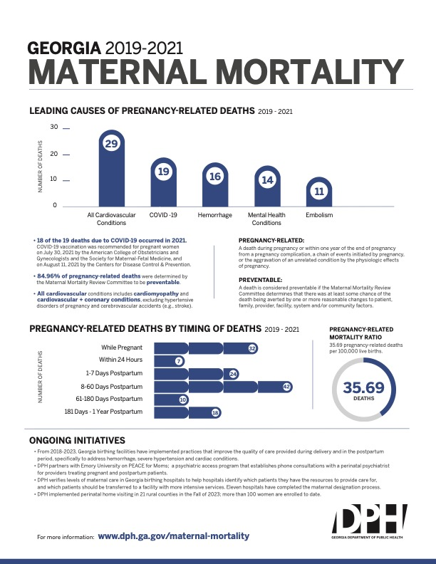

Slide 26
Maternal Morality in the U.S. Lowest
California 4%
Nevada 8.4%
Massachusetts 8.4%
(World Population Review, 2023)
Notes:
Efforts to address these inequities include increasing access to affordable, high-quality prenatal care for all individuals, implementing culturally competent care practices, expanding Medicaid eligibility, and addressing implicit biases among healthcare providers. By addressing these issues, we can work towards improving the health outcomes and overall well-being of marginalized populations.

Slide 27

Social Challenges in Georgia
Notes:
Addressing these root causes of inequity in obstetric care will require a multifaceted approach that includes increasing access to healthcare resources, diversifying the healthcare workforce, and providing culturally and linguistically appropriate care. Additionally, it will be important to dismantle implicit biases within the healthcare system and to ensure that all patients receive adequate education and support to make informed decisions about their pregnancy and childbirth.

Slide 28

Social Determinants of Health
This Photo by Unknown Author is licensed under CC BY-NC-ND
Notes:
Healthcare providers should work to identify and address social determinants of health that may impact a patient's ability to access and receive obstetric care, such as poverty, lack of access to transportation, or limited access to healthy food or safe living environments.

Slide 29

Structural Barriers
Notes:
Many marginalized communities face systemic barriers to accessing quality healthcare, including inadequate insurance coverage, a lack of available healthcare providers in their area, long wait times for appointments, and limited resources for transportation.

Slide 30

Racial and Ethnic Inequities
Notes:
Studies suggest that racial and ethnic minorities are less likely to receive adequate prenatal care, experience higher rates of complications during pregnancy, and have worse outcomes during childbirth than their white counterparts.

Slide 31

Language and Cultural Barriers
This Photo by Unknown Author is licensed under CC BY-NC
Notes:
Patients who do not speak English fluently or who come from different cultural backgrounds may struggle to communicate with their healthcare providers and have their needs and preferences accommodated.

Slide 32

Inadequate Patient Education and Literacy
Notes:
Patients from underprivileged communities may have limited access to health education resources, leading to misunderstandings about the risks and benefits of various obstetric interventions.

Slide 33

Mental Health and Social Support

Slide 34

Rural Healthcare Disparities

Slide 35

Implicit Bias
This Photo by Unknown Author is licensed under CC BY-SA
Notes:
Described when we have attitudes towards people or associate stereotypes with them without our conscious knowledge.

Slide 36

Experiences of Survivors
Knowledge to Action: Care Equity for Black Moms

Slide 37

Developing a Plan to Improve Maternal Outcomes
Step # 1: Assess and Acknowledge Disparities
Notes:
Start by acknowledging and assessing any disparities in obstetric care for birthing people in your organization or practice. Gather data on maternal mortality rates, infant mortality rates, quality of care, satisfaction rates, and other relevant metrics. Identify any disparities in outcomes and experiences between different groups of birthing people, such as race, ethnicity, income, and geographic location

Slide 38

Step # 2:Identify Root Causes
Notes:
Once you have assessed the disparities, identify the root causes of these differences. Consider factors such as implicit bias, structural racism, inadequate resources, and inadequate training and education for providers. Identify any other factors that contribute to disparities in care.

Slide 39

Step # 3: Develop a Comprehensive Plan
Notes:
Consider the following: Train providers in cultural humility and implicit bias
Increase access to insurance coverage and prenatal care
Ensure adequate staffing and resources in underserved areas
Provide education and support for patients and families
Implement quality improvement initiatives to address disparities and measure outcomes
Encourage community partnerships

Slide 40

Step # 4: Monitor and Evaluation of Progress
This Photo by Unknown Author is licensed under CC BY-SA
Notes:
Once the plan is implemented, monitor and evaluate progress regularly. Track metrics such as maternal and infant mortality rates, quality of care metrics, patient satisfaction rates, and provider satisfaction rates. Identify any areas for improvement and make necessary adjustments to the plan.

Slide 41

How is the State of Georgia Addressing this Crisis?

Slide 42
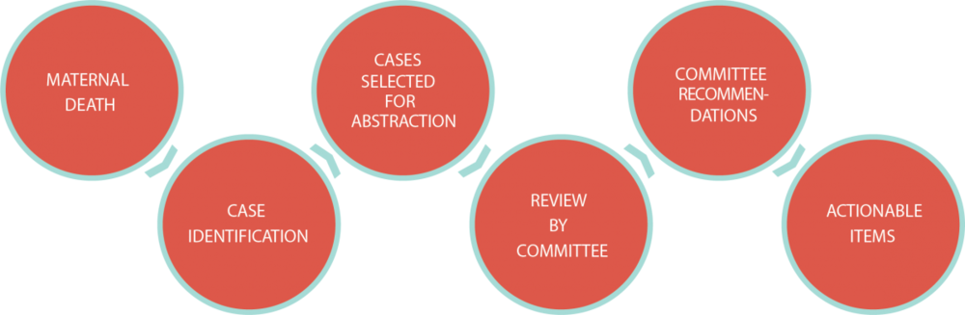
Maternal Mortality Review Committee
Notes:
Mission
To develop a better understanding of the causes of maternal death in Georgia, increase awareness of the issues surrounding pregnancy-associated death, and promote changes in systems, communities, and individuals in order to reduce the number of deaths.
Vision
All women in Georgia would have equitable access to health and health care before, during and after pregnancy to eliminate all preventable maternal deaths in Georgia.

Slide 43
Ongoing Initiatives
From 2018-2023, Georgia birthing facilities have implemented practices that improve the quality of care provided during delivery and in the postpartum period, specifically to address hemorrhage, severe hypertension and cardiac conditions.
DPH partners with Emory University on PEACE for Moms; a psychiatric access program that establishes phone consultations with a perinatal psychiatrist for providers treating pregnant and postpartum patients.
DPH verifies levels of maternal care in Georgia birthing hospitals to help hospitals identify which patients they have the resources to provide care for, and which patients should be transferred to a facility with more intensive services. Eleven hospitals have completed the maternal designation process.
DPH implemented perinatal home visiting in 21 rural counties in the Fall of 2023; more than 100 women are enrolled to date.

Slide 44
Resources
The National Association of Nurse Practitioners in Women’s Health has clinical positions statements to address structural racism and the maternal health crisis.
The Association of Women's Health, Obstetric and Neonatal Nurses provides a toolkit on respectful maternity care.
The National Birth Equity Collaborative provides resources on birth equity and focuses on birth equity for all birthing people.
The Alliance for Innovation for Maternal Health: Community Care Initiative provides maternal safety bundles.

Slide 45
Resources
ACOG (American College of Obstetricians and Gynecologists) has a guide for providing respectful maternity care to address disparities in maternal health outcomes.
The Black Mamas Matter Alliance is a Black women-led organization that advocates for policies to improve maternal health outcomes for Black women.
The National Association of Community Health Centers has a guide for providing culturally competent prenatal care for diverse populations.
The Health Equity Toolkit from the National Partnership for Women and Families provides resources and guidance on how to address health disparities in obstetrics care.
The American Medical Association has a resource hub for achieving health equity, including in obstetrics car

Slide 46

Call to Action
This Photo by Unknown Author is licensed under CC BY-NC

Slide 47
References
Center for Disease Control and Prevention. (2022) What is Health Equity. Retrieved from https://www.cdc.gov/nchhstp/healthequity/index.html
Collier, A. R. Y., & Molina, R. L. (2019). Maternal mortality in the United States: updates on trends, causes, and solutions. Neoreviews, 20(10), e561-e574.
Edmonds, J. K., & Fantasia, H. C. (2022). In Support of Reproductive Health Justice. Journal of Obstetric, Gynecologic & Neonatal Nursing, 51(6), 559-561.
Heavey, E. (2022). Rising US pregnancy-related deaths. Nursing2022, 52(8), 36-39.
Kramer, M. R., Labgold, K., Zertuche, A. D., Runkle, J. D., Bryan, M., Freymann, G. R., ... & Dunlop, A. L. (2023). Severe maternal morbidity in Georgia, 2009–2020. Medical care, 61(5), 258.
Taylor, J. K. (2020). Structural racism and maternal health among Black women. Journal of Law, Medicine & Ethics, 48(3), 506-517.
World Population Review. (2023) Maternal Mortality Rate by State 2023. (2023). Retrieved from https://worldpopulationreview.com/state-rankings/maternal-mortality-rate-by-state

Slide 48

Contact Information
Shawana S. Moore
Email: Shawana.moore@emory.edu

Slide 49

Questions

Slide 50

Maternal Health, Mortality and Research Studies
Suchitra Chandrasekaran, MD MSCE
Associate Professor
Director, MFM Research
Division of Maternal Fetal Medicine
Department of Gynecology and Obstetrics
Secondary Appt: Hubert Dept. Global Health, RSPH
2/22/2024

Slide 51

FINANCIAL DISCLOSURE
No Financial Disclosures

Slide 52
OBJECTIVES
Obstetric Care Access In Georgia
Determinants Affecting Maternal Health
Research Initiatives Impacting Maternal Mortality

Slide 53
BACKGROUND
State of GA: 66.3 deaths/100,000 live births
National Rate: 29.6 deaths/100,000
Highest rates among those who are Black, publicly insured or uninsured.
53% are within 64 days postpartum

Slide 54
BACKGROUND
Contributors to Severe Morbidity and Mortality in the state:
  Obesity: 42%
  Bias/Discrimination: 15%
  Mental Health Conditions 18%
  Substance Use 13%
Majority of deaths are occurring intrapartum/peripartum period
  Obesity
  Cardiovascular
  Metabolic disease
60% are cardiac related (cardiomyopathy, cardiovascular disease, embolism, preeclampsia)

Slide 55
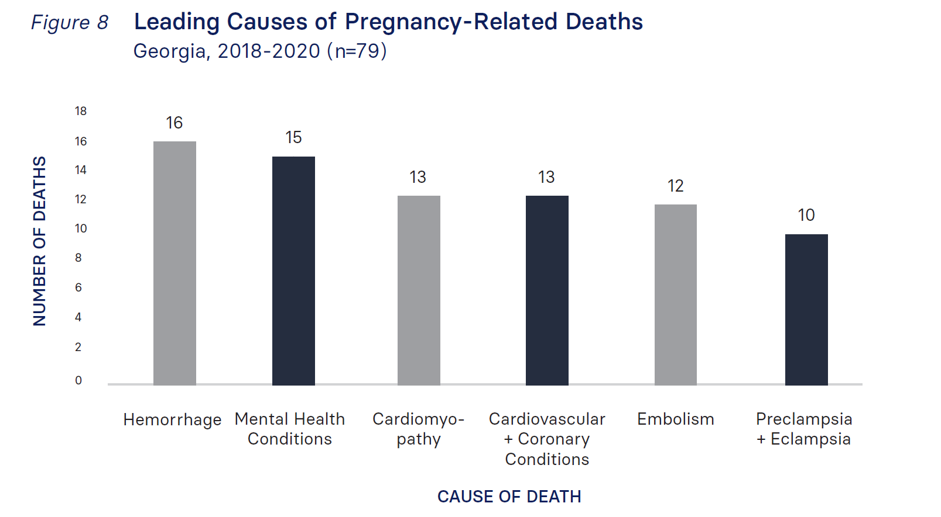
BACKGROUND
2018-2020 MMRC Report

Slide 56
BACKGROUND
2018 - 2022, multiple changes to improve SMM have been implemented including
  Postpartum Medicaid Extension
    Covers Care for 1 year postpartum
  Perinatal Levels of Care Designation
  Georgia Perinatal Quality Collaborative (GaPQC) Implementation of AIM and Hypertension Bundles
  Multidisciplinary MMRC (meeting quarterly to review deaths)

Slide 57
ACCESS: MATERNITY CARE DESERTS
Counties in the US in which access to maternity care services is limited or absent
Without a birthing hospital or birth center offering obstetric care or obstetric provider
Obstetric Provider
  Obstetrician
  Family Physician
  Certified Nurse Midwives
  Nurse Midwives
United States:
  2 million reproductive age persons live in maternity care deserts
  130,000 babies born in maternity care deserts
  1,052 counties

Slide 58
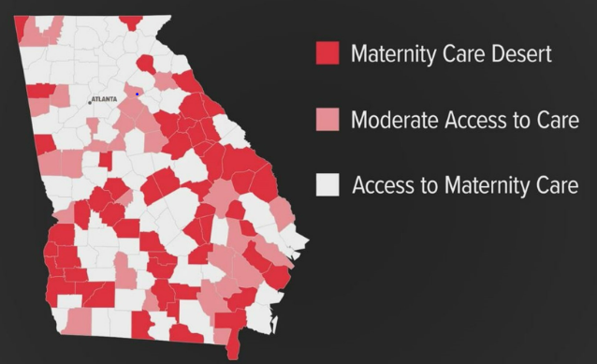
MATERNITY CARE DESERT GEORGIA
Moderate Access:
  Access to 1 hospital or birth center
  Few obstetric providers (<60 per 100,000 births)
Access:
  Availability of 2 or more hospitals or birth centers providing obstetric care
  At least 60 providers per 100,000 births

Slide 59
MATERNITY CARE DESERT GEORIGA
The Georgia Board of Health Care Workforce 2019 Annual Report
  9 Georgia counties without a physician
  18 without a family physician
  32 without an internist
  77 without a psychiatrist

Slide 60
OBJECTIVES
Obstetric Care Access In Georgia
Determinants Affecting Maternal Health
Research Initiatives Impacting Maternal Mortality

Slide 61
DETERMINANTS OF MATERNAL HEALTH
QUALITY
  The standard of something as measured against other things of a similar kind
  The degree of excellence of something
EQUALITY
  Equal treatment for all
EQUITY
  The quality of being fair and impartial

Slide 62

DETERMINANTS OF MATERNAL HEALTH
Urban setting
Access to care
Adequate insurance coverage
Support systems
Underserved setting
No obstetric services
No insurance coverage
Affected by other social determinants of health
National Evidence Based Guidelines
Hospital Protocols
In theory, could go to any hospital/clinic for care
Improved insurance access/payor coverage for all peripartum care (including postpartum –Medicaid Extension)
Telehealth options
Support systems (mental health, nutrition, primary care)
Transport to higher levels of care when needed in a seamless fashion

Slide 63
DETERMINANTS OF HEALTH
Georgia’s Maternal Mortality Review Committee (MMRC)
  70% of Georgia’s maternal deaths are preventable
Key contributors
  Poorly controlled chronic health conditions
  Mental health conditions
  Health system that offers poorly-coordinated care, particularly in the postpartum period
Among key solutions, the MMRC recommends
  Improved postpartum follow-up and case management
  Especially with chronic mental health conditions and cardiometabolic complications of pregnancy

Slide 64
OBJECTIVES
Obstetric Care Access In Georgia
Determinants Affecting Maternal Health
Research Initiatives Impacting Maternal Mortality

Slide 65
CLINICAL APPROACH: TRANSITIONS OF CARE

Slide 66
INITIATIVE: EQUITY IN POSTPARTUM CARE
Postpartum Clinic
Telehealth and In Person Options
All patients with a cardiometabolic issue in pregnancy
Multidisciplinary care
  Mental Health
  Nutrition
  Primary Care
  Cardiology
  Endocrinology
Paradigm Shift in Postpartum Care

Slide 67
POSTPARTUM CARDIOMETABOLIC CLINIC
ELIGIBLE PATIENTS:
Any Hypertensive Disease in Pregnancy
Any diabetes in pregnancy
Other cardiometabolic issue not including adult congenital heart disease
Refer patients either during pregnancy after diagnosis of HDP or DM
Will be scheduled out 12 weeks postpartum ; does not replace standard postpartum visit
In-person visits and Telehealth visits are both options
Clinic Started 9/2022

Slide 68
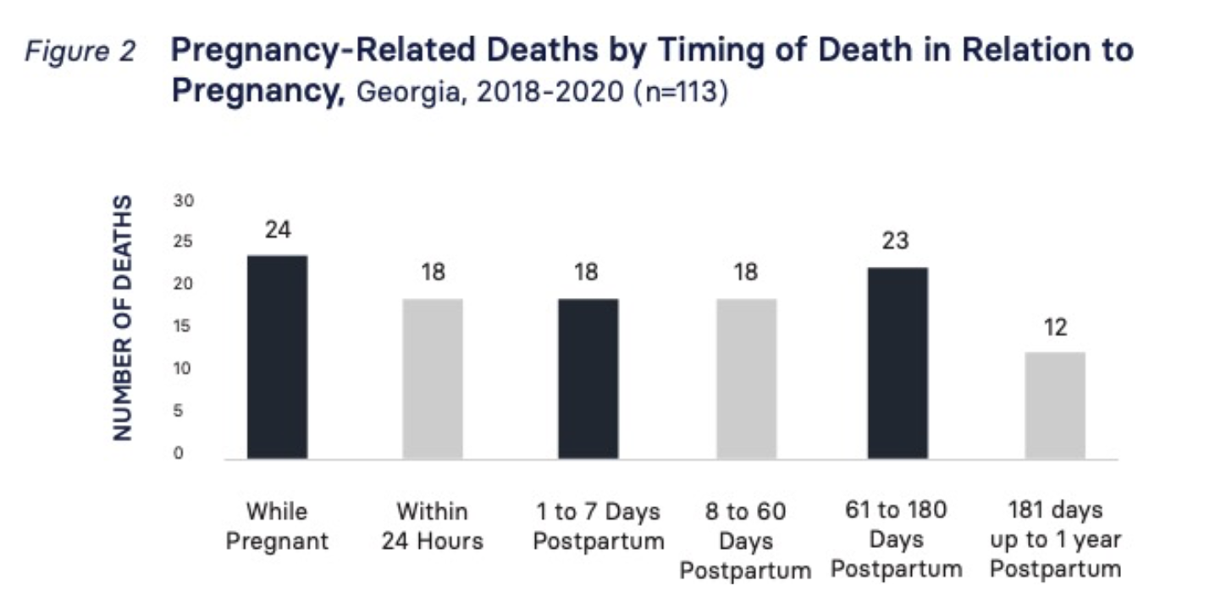
POSTPARTUM CARDIOMETABOLIC CLINIC
2018-2020 MMRC Report

Slide 69
 | Overall (n=150) | Attended PPMC (n=93) | Did not attend PPMC (n=57) | p-value
Demographic information
Age (years); mean (SD) | 33.2 (5.7) | 33.6 (5.4) | 32.4 (6.1) | 0.243
Race African American Caucasian Asian Unknown | 110 (73.3) 25 (16.7) 9 (6.0) 6 (4.0) | 64 (68.8) 19 (20.4) 7 (7.5) 3 (3.2) | 46 (81) 6 (11) 2 (3) 3 (5) | 0.263
Ethnicity Hispanic Non-Hispanic Unknown | 10 (6.7) 134 (89.3) 6 (4.0) | 7 (7.5) 82 (88.2) 4 (4.3) | 3 (5.3) 52 (91.2) 2 (3.5) | 0.916
Insurance Public Private Uninsured/self-pay | 40 (26.7) 109 (72.7) 1 (0.7) | 21 (22.6) 72 (77.4) 0 (-) | 19 (33.3) 37 (64.9) 1 (1.8) | 0.104
Education High school College Post-graduate school Unknown | 9 (6.0) 39 (26.0) 43 (28.7) 59 (39.3) | 7 (7.5) 26 (28.0) 30 (32.3) 30 (32.3) | 2 (3.5) 13 (22.8) 13 (22.8) 29 (50.9) | 0.149
Gravidity; mean (SD) | 2.8 (2.0) | 2.5 (1.6) | 3.3 (2.4) | 0.072
Parity; mean (SD) | 2.0 (1.6) | 1.8 (1.0) | 2.4 (2.2) | 0.182
RESULTS

Slide 70
 | Overall (n=150) | Attended PPMC (n=93) | Did not attend PPMC (n=57) | p-value
Demographic information
Age (years); mean (SD) | 33.2 (5.7) | 33.6 (5.4) | 32.4 (6.1) | 0.243
Parity; mean (SD) | 2.0 (1.6) | 1.8 (1.0) | 2.4 (2.2) | 0.182
Cardiometabolic history
Reason for PPMC referral Diabetic indication¹ Hypertensive indication² Maternal cardiac disease | 44 (29.3) 137 (91.3) 4 (2.7) | 29 (31.2) 85 (91.4) 1 (1.1) | 15 (26.3) 52 (91.2) 3 (5.3) | 0.525 0.971 0.154
Visits attended or scheduled within 6 months postpartum Any (≥ one specified below) Primary Care Cardiology Endocrinology | 89 (59.3) 51 (34.0) 58 (38.7) 11 (7.3) | 68 (73.1) 38 (40.9) 48 (51.6) 9 (9.7) | 21 (36.8) 13 (22.8) 10 (17.5) 2 (3.5) | <0.001 0.023 <0.001 0.207
Labs available for review after PPMC visit Lipids/triglycerides Hemoglobin A1c 2-hr Glucose Tolerance Test | 31 (20.7) 30 (20.0) 9 (6.0) | 27 (29.0) 26 (28.0) 7 (7.5) | 4 (7.0) 4 (7.0) 2 (3.5) | 0.002 0.002 0.484
# Postpartum days that PPMC visit occurred (days); mean (SD) |  | 90.8 (18.3) | N/A
PPMC visit type In-person Virtual |  | 30 (32.3) 63 (67.7) | N/A
Other co-existing conditions addressed during PPMC visit Nutrition/weight loss Mental health |  | 58 (62.4) 41 (44.1) | N/A
RESULTS

Slide 71
COMMUNITY ENGAGEMENT
STATE ENGAGEMENT

Slide 72




R01MD016031
Principal Investigators
  Anne Dunlop, MD MPH
  Kathleen Adams, PhD
  Sheree Boulet, PhD

Slide 73
COMBINES:
  Statewide assessment of racial disparities in adverse maternal health outcomes
  Evaluation of Georgia’s Medicaid Inter-pregnancy Care Program
  Randomized trial of a comprehensive postpartum care system in an urban safety-net hospital.
Fill critical gaps in knowledge regarding policy and health system approaches for reducing disparities in maternal morbidity and mortality.

Slide 74
INTERSECTION OF MENTAL HEALTH AND MATERNAL METABOLIC HEALTH

Slide 75

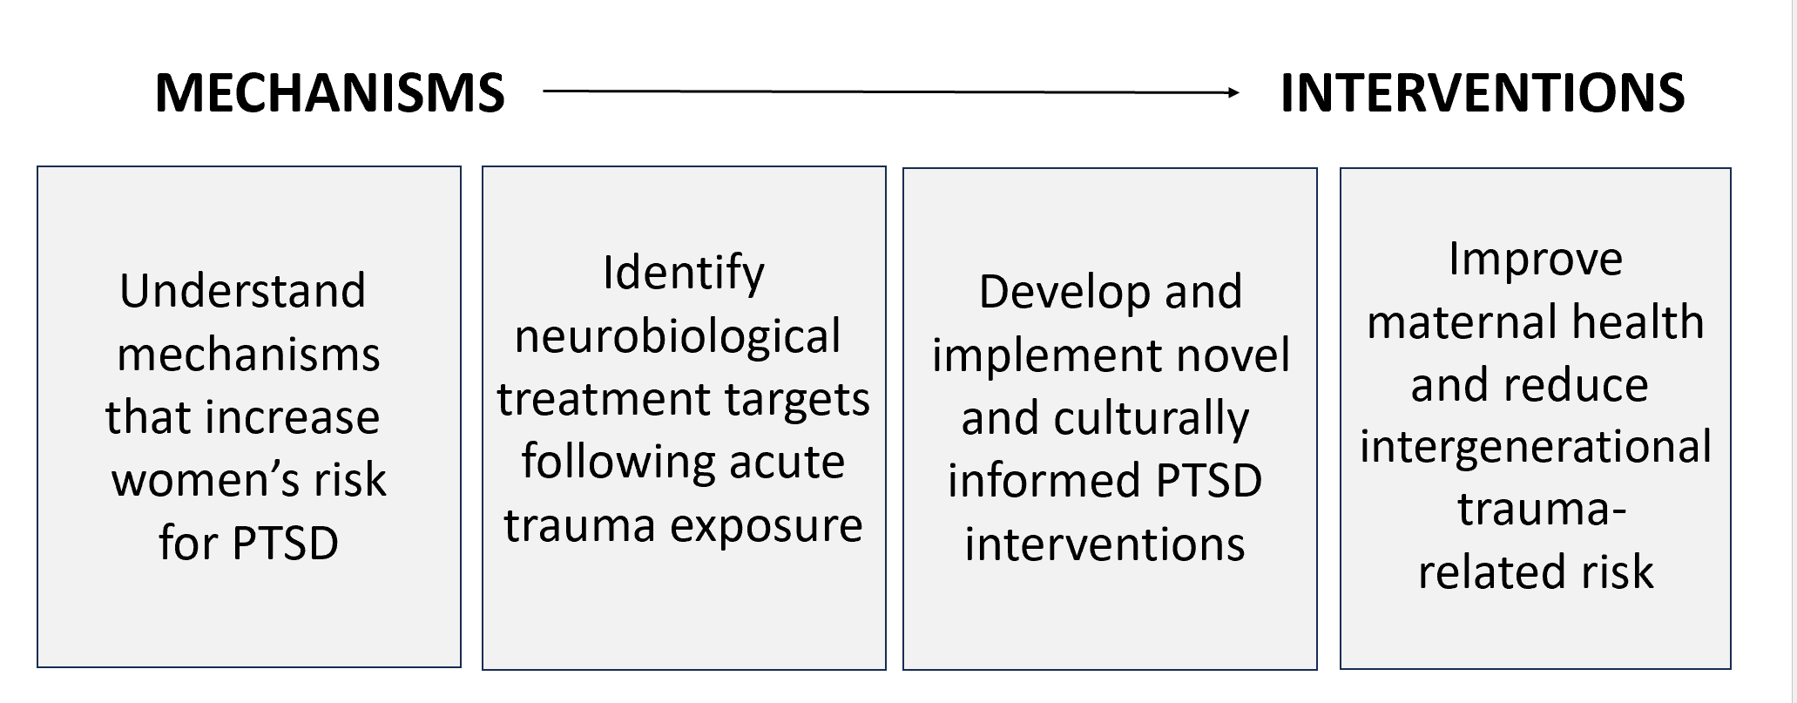

Slide 76
Trauma Type | % Exposed
Natural Disaster | 30.5
Experienced Serious Accident or Injury | 54.7
Experienced Sudden Life-threatening Illness | 29.6
Military Combat or Military Service in a War Zone | 2.5
Witnessed Close Friend/Family Member Murdered | 13.4
Domestic Violence | 43.0
Attacked by non-romantic partner | 46.1
Witnessed Family Member Attacked | 41.6
Witnessed Non-family Member Attacked | 45.2
Witnessed Violence between Caregivers | 31.8
Experienced Physical Abuse | 19.7
Experienced Emotional Abuse | 27.3
Experienced Sexual Abuse prior to age 18 | 28.7
Experienced Sexual Assault (age 18+; with physical force) | 12.0
Sexual Violence (any age) | 33.4
Mod-or-sev Child Abuse (physical, sexual or emotional) | 38.0
Trauma Exposure in Women Seeking Non-Psychiatric Care at Grady Memorial Hospital
N>7,500
Gluck et. al. 2021 – Archives of Women’s Mental Health

Slide 77
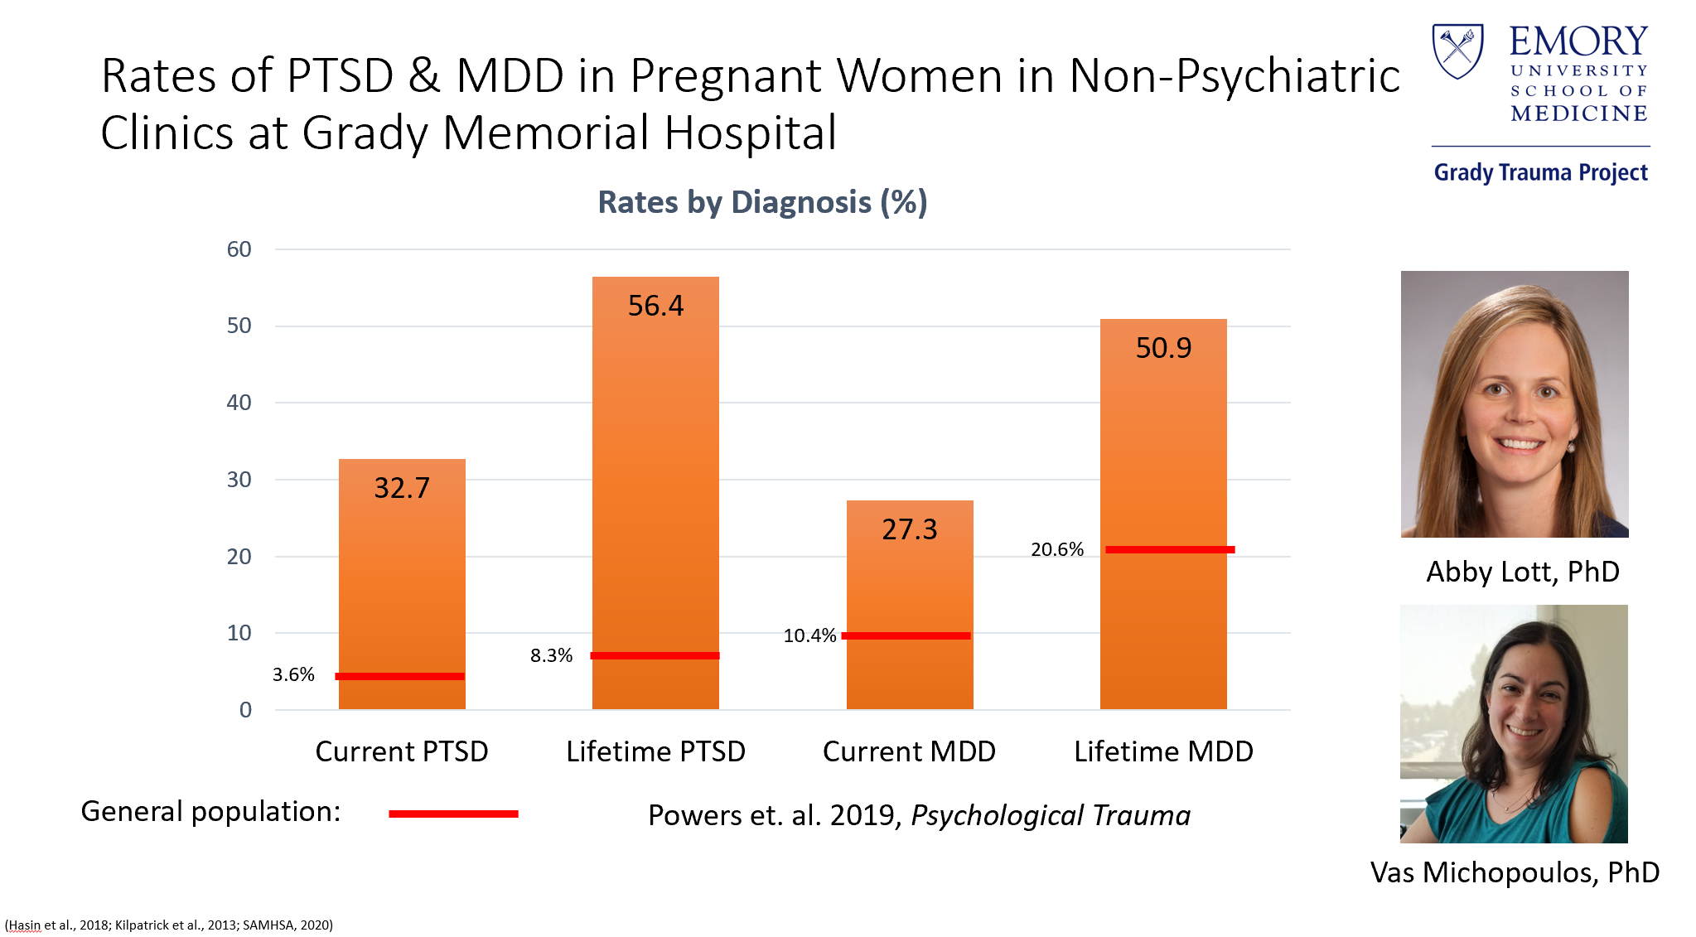

Slide 78
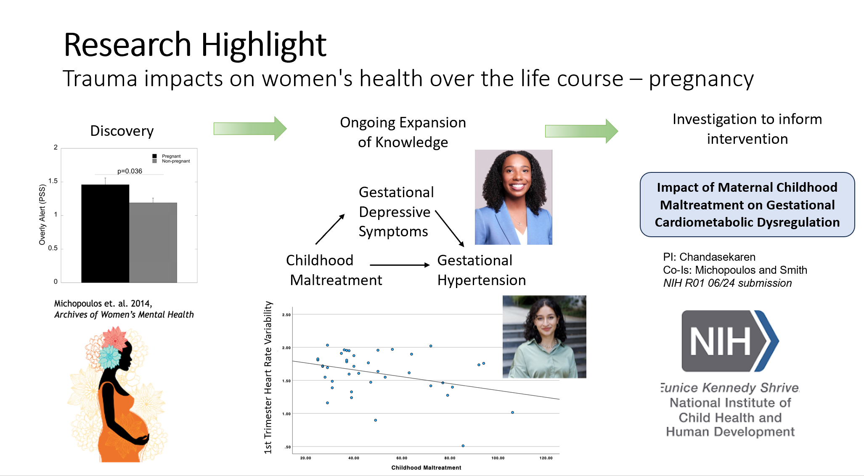

Slide 79
STATE SURVEY DATA
EMORY MATERNAL MORBIDITY AND MORTALITY WORKING GROUP

Slide 80
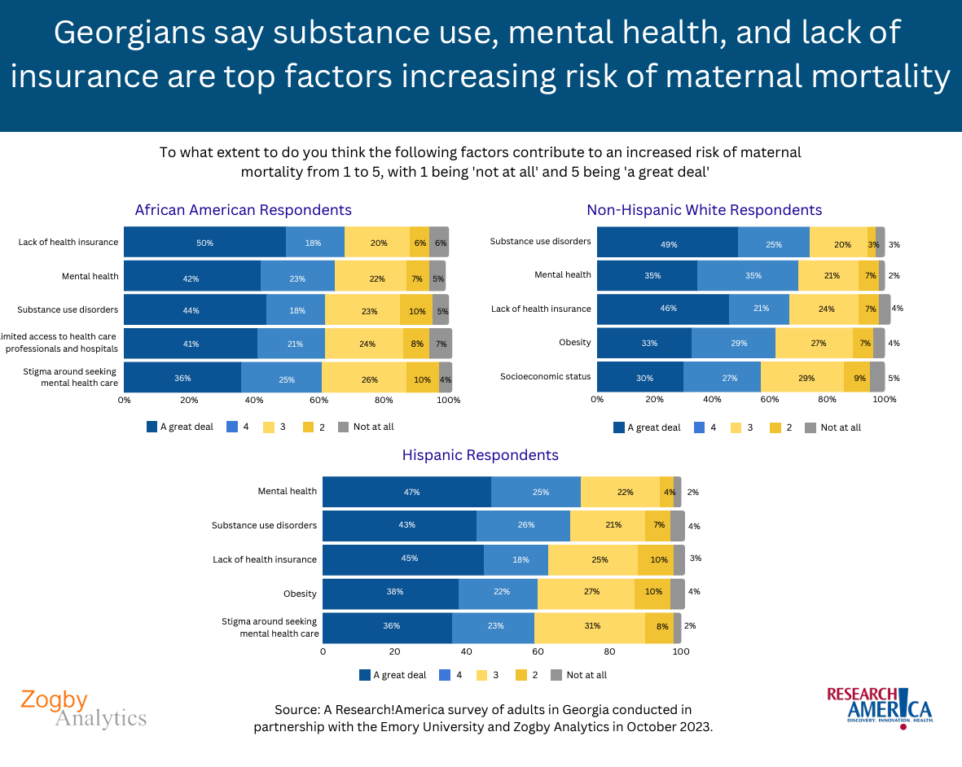

Slide 81
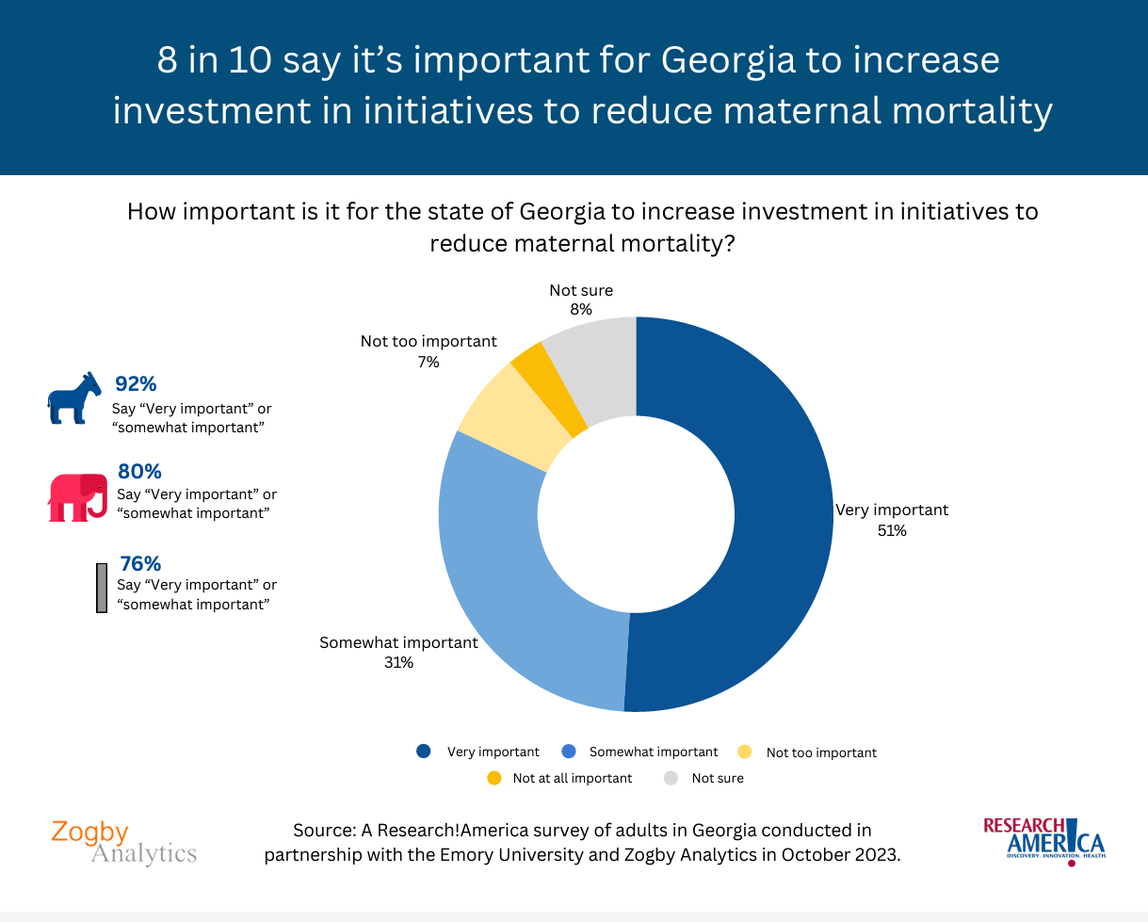

Slide 82
TAKE HOME POINTS
Maternal Morbidity and Mortality is complex
Issues at Multiple Levels
We NEED the Evidence: Research Matters
Research at all levels
  Clinical
  Translational
  Implementation
  Social/Public Health Impacts

Slide 83
THANK YOU!

Slide 84
Accreditation Statement
The Emory University School of Medicine is accredited by the Accreditation Council for Continuing Medical Education (ACCME) to provide continuing medical education for physicians.
Credit Designation Statement
The Emory University School of Medicine designates this live activity for a maximum of 1.5 AMA PRA Category 1 Credits™. Physicians should claim only the credit commensurate with the extent of their participation in the activity.
Disclosure Statement
In accordance with the ACCME Standards for Integrity and Independence in Accredited Continuing Education, all relevant financial relationships, and the absence of relevant financial relationships, must be disclosed to the learners for all individuals in control of content:
Before the learners engage with the accredited education
In a format that can be verified at the time of accreditation
None of the planners or speakers for this educational activity have relevant financial relationship(s) to disclose with ineligible companies. Ineligible companies are those whose primary business is producing, marketing, selling, re-selling, or distributing healthcare products used by or on patients.
No grant support was received for this activity.

Slide 85
Closing Remarks
This seminar's recording, PowerPoint presentation, and survey will be available on the OCR’s website within a week at
http://www.ocr.emory.edu/training/research%20matters.html
Our next Research Matters educational seminar will be
June 27, 2024.
See you this summer!!!

