Slide 1

Research Matters
Office for Clinical Research
June 15, 2023

Slide 2

Seminar Recording

Slide 3
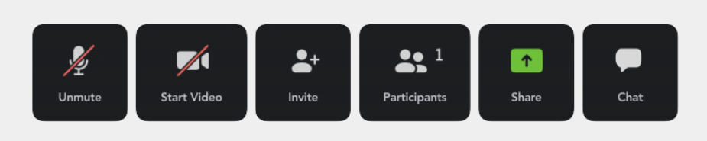

Seminar Facilitation
Be sure to MUTE during the seminar to avoid any background noise.
Place your CAMERA on so we can see you for engagement.
Please utilize the CHAT area to submit questions.
OR
Raise your HAND.

Slide 4
Agenda
11:30 am – 11:35 am Welcome & General Announcements
11:35 am – 12:30 pm Bridging the Gap Between Mental and Physical Health
Includes Q&A Brandon Kitay, MD, PhD
Assistant Professor
Emory University School of Medicine: Psychiatry
12:30 pm – 12:45 pm Self-Care & FSAP
Includes Q&A Mellonie Hayes Mullins, PhD, LMFT
FSAP Education Coordinator
Emory University School of Medicine: Human Resources: Faculty Staff
Assistance Program
12:45 pm – 1:00 pm OnCore and Epic Updates
Includes Q&A Bridget Strong-Benson, PhD(c), MBA, CRP
Director of Clinical Research Education & QI
Emory University: School of Medicine: Office for Clinical Research
1:00 pm Closing Remarks

Slide 5
Seminar Objectives
To provide information on NeuroFlow and the Collaborative Care Model.
To provide self-care and ways to obtain assistance with FSAP.
To provide an update on OnCore and Epic.

Slide 6

Announcements
General Announcements

Slide 7

Mental Health Awareness
Emory News

Slide 8


Slide 9
OCR Announcements
Emory Healthcare Credentialing Zoom Office Hours
Starting June 2023, the EHC Credentialing Office will host office hours via Zoom from 11:00 am - 1:00 pm EST on the
2nd and 4th Wednesday of each month for Emory University Researchers to address questions and concerns.
View details on OCR's website at https://ocr.emory.edu/resources/training/courses.html > Clinical Research Orientation and EHC Credentialing Review.

Slide 10


Slide 11

Integrated Behavioral Health: Bridging the Gap Between Mental and Physical Health
Department of Psychiatry
and Behavioral Sciences
Emory University, Research Matters
15 June 2023
Brandon Kitay, MD, PhD (he/him)
Director, Behavioral Health Integration, Emory Healthcare
Assistant Professor of Psychiatry and Behavioral Sciences
bkitay@emory.edu

Slide 12
Disclosures: Personal/Professional Financial Relationships with Industry
External Industry Relationships * | Company Name(s) | Role
Equity, stock, or options in biomedical industry companies or publishers** | None
Board of Directors or officer | None
Royalties from Emory or from external entity | None
Industry funds to Yale University for the conduct of research | Janssen Pharmaceuticals – esketamine Sage Therapeutics – SAGE-217 | Sub-investigator for clinical trials: ESKETINSUI3001, ESKETINTRD3008 Sub-investigatory for clinical trials: SAGE-217-303 (Shoreline Study)
Other | Janssen Pharmaceuticals (USA, Southeast Asia, Singapore, Hong Kong, Philippines) Otsuka Pharmaceuticals Assured Investment Management, LLC Biogen Boehringer Ingelheim | Consultant, expert speaker Program co-chair for the PsychU National Forum (educational resource sponsored by entity) Consultant Consultant, scientific advisory boards Consultant, scientific advisory Boards
*Consulting, scientific advisory board, industry-sponsored CME, expert witness for company, FDA representative for company, publishing contract, etc.
**Does not include stock in publicly-traded companies in retirement funds and other pooled investment accounts managed by others.

Slide 13
Objectives
Become oriented to “integrated behavioral health” models of care and the rationale for their use
Understand the evidence-base supporting integrated behavioral health models
Identify opportunities for research in integrated behavioral health from the perspective of implementation science, clinical trials, and health services
Notes:
Samantha
… Why CoCM?

Slide 14


What is “Integrated Healthcare”?
Expert consensus:
Integrated care is “a model of service delivery that combines care for physical, mental, and substance use disorders in a collaborative way to address problems identified during primary care visits.”¹
Increase ACCESS
Improve QUALITY
1. Peek CJ and the National Integration Academy Council. Executive Summary--Lexicon for Behavioral Health and Primary Care Integration: Concepts and Definitions Developed by Expert Consensus. AHRQ Publication No.13-IP001-1-EF. Rockville, MD: Agency for Healthcare Research and Quality. 2013

Slide 15


How difficult is it to access a psychiatrist at Emory Healthcare?
FY2021
> 80 Primary Care Clinics
7,701 new patient appointment requests
2,530 patients scheduled
~21,000 “new patient” calls
Adult Outpatient Psychiatry
= 7.68 MD Clinical FTE
Notes:
What was not readily apparent however, was the SCOPE of the ACCESS problem… this took some considerable networking and digging with our data analysists, business leads and administrators… but what I found was that the problem is MUCH larger than anyone anticipated…
The Emory Healthcare Network is a LARGE, heterogeneous entity distributed across a large geographic area of northwest GA. The clinical footprint of Adult Outpatient Psychiatry is one floor of physicians comprised of 7.68 total clinical effort…
In FY2021 we received potential internal referrals from over 70 “Primary Care Clinics” NOT including other outpatient specialty services and our call center received over 21,000 inquiries from patients not established at Emory Healthcare for mental health services…
Ultimately, about 7700 appointment requests were filtered through and only ~2500 patients were scheduled for an appointment… at best, we were able to field about 1/3 of new patient requests that that made it past initial screening…
We have no direct data on what happened to the other 2/3…

Slide 16
Top 10 Primary Care ICD-Codes, Mar 2019 – Feb 2020
ICD Code | ICD Diagnosis | Primary | Secondary | Grand Total
I10 | Essential (primary) hypertension | 14396 | 18791 | 33187
Z00.00 | Encounter for general adult medical examination without abnormal findings | 18388 | 3635 | 22023
Z23 | Encounter for immunization | 12965 | 8011 | 20976
E11.9 | Type 2 diabetes mellitus without complications | 6136 | 5263 | 11399
E78.5 | Hyperlipidemia, unspecified | 848 | 7162 | 8010
K21.9 | Gastro-esophageal reflux disease without esophagitis | 491 | 3703 | 4194
F41.9 | Anxiety disorder, unspecified | 1309 | 2652 | 3961
E03.9 | Hypothyroidism, unspecified | 717 | 3027 | 3744
F32.9 | Major depressive disorder, single episode, unspecified | 861 | 2707 | 3568
E78.00 | Pure hypercholesterolemia, unspecified | 237 | 2368 | 2605
Sampling of Primary and Secondary Billing Diagnoses (ICD-Codes) from 8 metro-Atlanta EHC Primary Care clinics (N= 322,587 total encounters)
Notes:
…but it is likely that most of these patients receive treatment in Primary Care…

Slide 17
Nationally, primary care already does a majority of behavioral health management
20-40% of primary care patients have behavioral care needs
Up to 80% of antidepressants are prescribed by primary care physicians
75% of patients with depression see primary care providers
Depression goes undetected in >50% of primary care patients
Only 20-40% of patients improve substantially in 6 months without specialty assistance
Only about half of patients referred to specialty care follow through
Mitchell AJ, et al: Clinical diagnosis of depression in primary care:a meta-analysis.The Lancet; 2009; 374:609-619.
Schulberg HC, Block MR, Madonia MJ, et al: Treatment of major depression in primary care practice: 8-month clinical outcomes. Arch Gen Psychiatry 1996; 53:913-919

Slide 18
Health complexity requires individualized physical and behavioral health care integration
% of Patients
% of Costs
Patient Type
100
90
80
70
60
50
40
30
20
10
Acute Illness
Low
1/3
Chronic or Serious Illness
Medium
1/3
High
1/3
High Complexity: Physical & mental health co-morbidities
Adapted from Meier DE, J Pall Med, 7:119-134, 2004

Slide 19
Synergistic benefits of highly-coordinated physical and behavioral health management
Improved medical, behavioral health, financial, satisfaction and functional outcome measures compared with “treatment as usual.”
Effective management of depression in ________ :
  cancer patients improves fatigue, depression, and anxiety levels
  coronary artery disease patients improves prognosis, depression, and satisfaction
  diabetes patients improves mortality, diabetes control, psychosocial functioning
Katon et al, N Engl J Med, 2010; Rollan et al, JAMA, 2009; Davidson KW et al, Arch Intern Med, 2010; Ell K et al, Diabetes Care, 2010; Bogner HR et al, Diabetes Care, 2007

Slide 20
Why pursue integrated behavioral healthcare?
Behavioral health disorders have a high prevalence globally and contribute to:
  Decreased quality of life
  Risk for worsening other health outcomes (e.g. diabetes/hypertension management, coronary artery disease outcomes, chronic pain, etc.)
  Increased health care costs: i.e. healthcare costs are more than three time greater for Medicaid enrollees with a psychiatric co-morbidity than those without.
Behavioral health conditions frequently go undiagnosed and untreated, i.e. only 22% of U.S. adults with common mental health disorders receive care from any type of mental health specialist (Wang PS et al., Psych Serv, 2005); primary care patients with 1 chronic medical condition have 2x higher rates of psychiatric co-morbidity, those with 4 or more have 5x higher rates! Batnett K et al., Lancet, 2012)
Patient engagement in specialty referral is low
Patients prefer receiving treatment from providers with whom they have an established relationship
Multimodal specialty treatment is costly to the payor

Slide 21
Barriers to Accessing Behavioral Health Resources
Demand and need far in excess of supply
2. Lack of systematic triage and low-intensity, “first-pass” interventions
3. Absence of care navigation support for patients and non-specialty clinicians
4. Reimbursement that discourages insurance-based practices in the community
Notes:
Effective -- ”because it is measurement informed” it affords quantifiable change
Timely – “for primary care, it is ‘treatment in my own backyard!’”
Synergistic – ”the product of this team is greater than the sum of its parts” – medical outcomes, cost savings for the patient and health system, etc.

Slide 22
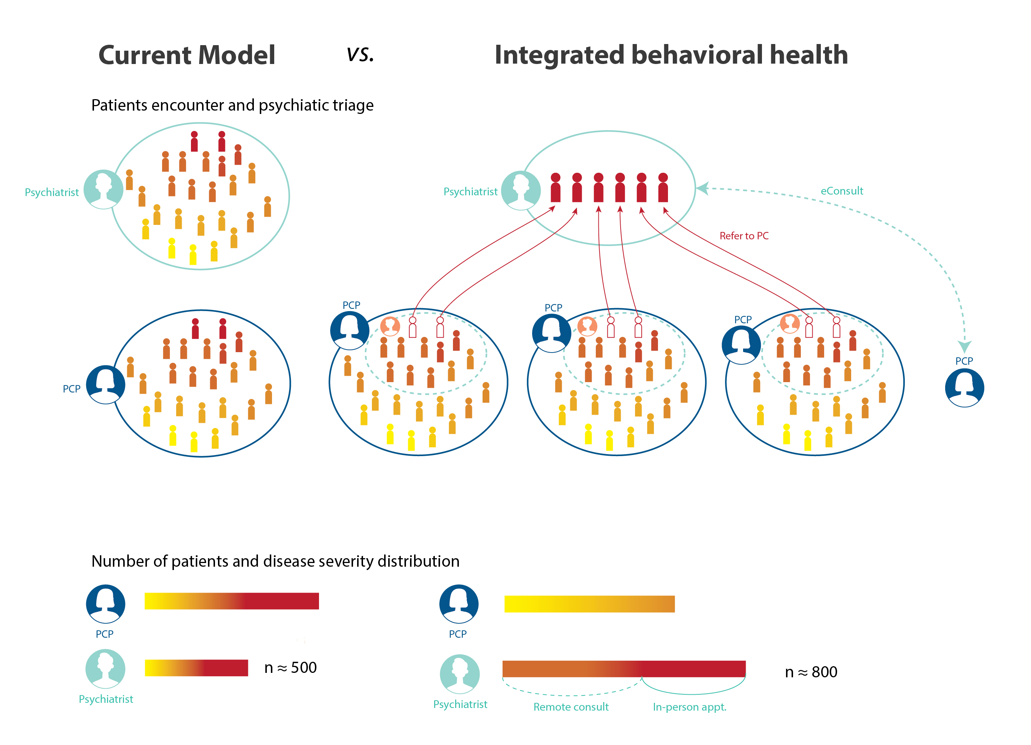
The current model of 1:1 referral does not work

Slide 23

Emory Integrated Behavioral Health – Our True North
N
MISSION
Expand access to timely mental health resources at the appropriately level of care
VISION
  Seamless entry, transition, and egress from anywhere within the health system
ACCESS:
Patient – direct or indirect
Provider – education or consultation
VALUES
  Respect for the needs of patients and colleagues
  Interdepartmental citizenship
  Excellence in execution
  Diversity from staff to solution
  Practical innovation
TRUE NORTH PILLARS AND STRATEGIC PRIORITIES
Patient Experience
Create an excellent introduction to – and navigation of services
Quality
Evidence-based with measurement informed outcomes
Sustainability
Implement fiscally viable programs with optimized workflows
Strategic Growth
Expand access via novel partnerships & mechanisms
Research & Education
Advance, apply, and disseminate knowledge
Notes:
Your true north, your singular goal
Patient experience – mitigate stigma, promote adherence and engagement
Quality – anchor and improve care with quantifiable metrics
Sustainability – remain adequately resourced/staffed
Strategic Growth – thinking beyond primary care, linkage with other specialties and patient populations
Research & Education – help make our colleagues more effective and advance the field of “integration”

Slide 24
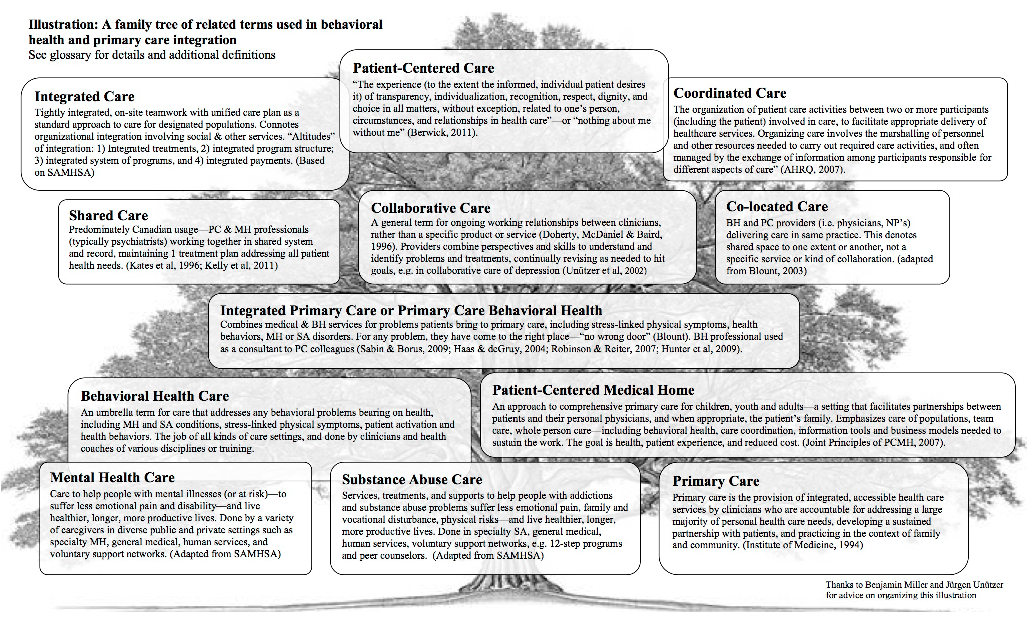
Peek CJ and the National Integration Academy Council, 2013

Slide 25
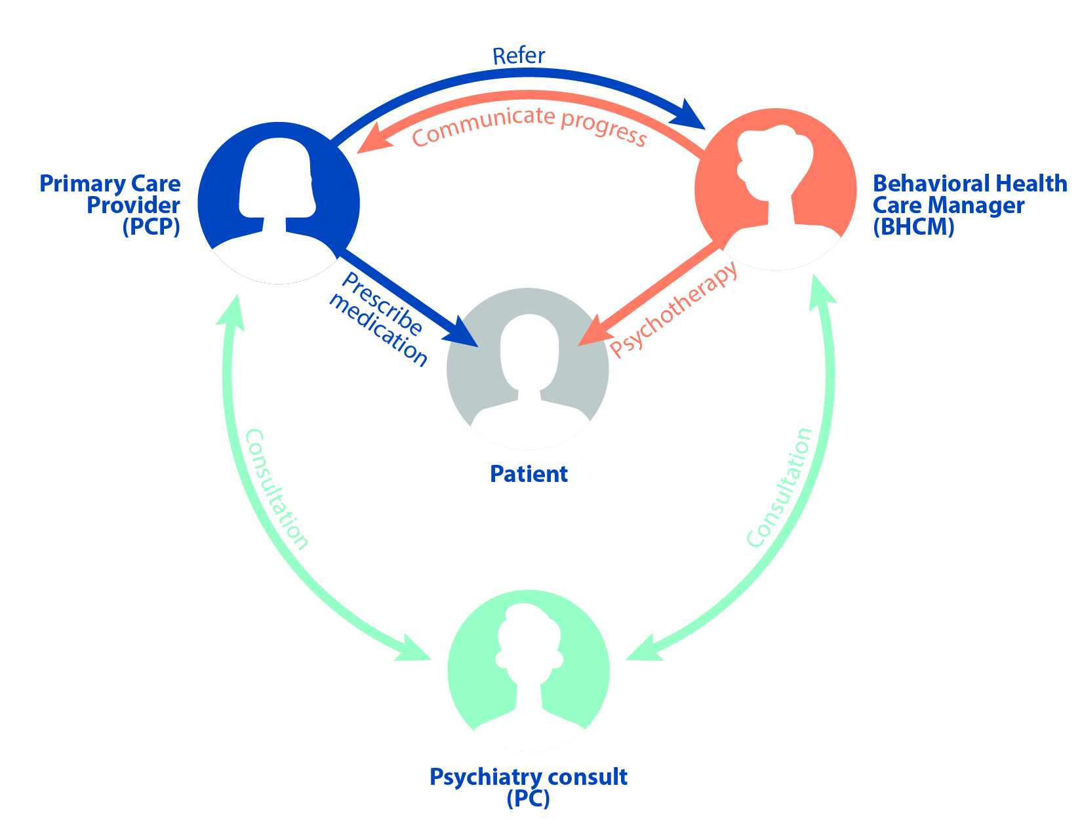


Emory Integrated Behavioral Health
Roadmap of ACCESS solutions: Phase 1
Potential Referrals
Collaborative Care (CoCM)
Gold Standard: On-site, evidence- and team-based care
Patient access to care coordination and psychotherapy
Therapist and PCP access to psychiatric consultation
Intervention influencing physical ← → behavioral health
Sustainable billing model

Slide 26
Emory Integrated Behavioral Health
Roadmap of ACCESS solutions: Phase 1
Potential Referrals
e-Consults
Collaborative Care (CoCM)
Formalizing “curbside consultation” for medication management through the EMR – PCP access to psychiatric expertise
Sustainable billing model
Recommendations become part of the EMR
Mitigates need for “in-person” psychiatric consultation

Slide 27

Emory Integrated Behavioral Health
Roadmap of ACCESS solutions: Phase 1
Potential Referrals
e-Consults
Collaborative Care (CoCM)
Patient facing smartphone app. – personalized patient access to psychotherapy (mild-moderate severity)
Patient driven “care journeys” (e.g. digital cognitive behavioral therapy)
Integrates with the EMR for passive monitoring (e.g. failure to improve)
Behavioral economics (e.g. patient rewarded for engagement)
Digital Health
Solutions

Slide 28
The current model of 1:1 referral does not work

Slide 29

Integrated Behavioral Health:
Distributing resources for timely and appropriate level of access
Notes:
“What has been the greatest challenge to implementing an IBH initiative? (Please elaborate in the chat)”

Slide 30
How well does Collaborative Care satisfy the IBH mission?
Evidence-based
  Effective
  Timely
  Synergistic
Scalable
    1 clinic ~ 100 CoCM patients
    1 BHCM : 1 clinic
    0.1 FTE Psychiatrist : n Clinics
Sustainable
    CPT = $
Psychiatric Consultant
(PC)
Notes:
Effective -- ”because it is measurement informed” it affords quantifiable change
Timely – “for primary care, it is ‘treatment in my own backyard!’”
Synergistic – ”the product of this team is greater than the sum of its parts” – medical outcomes, cost savings for the patient and health system, etc.

Slide 31
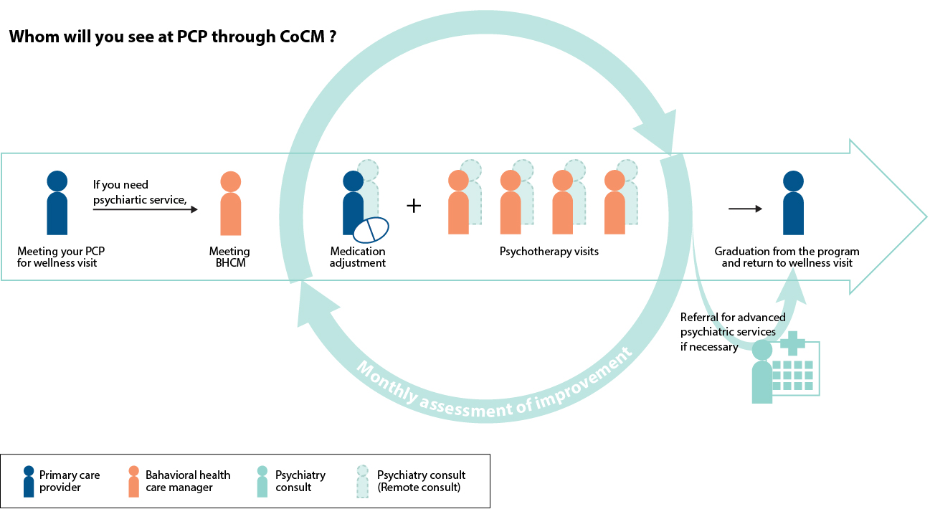
Collaborative Care Model – Treatment “Episode”
6 – 12 months
Notes:
But for the populations I am hoping to serve, is this model scalable enough? What are my current re

Slide 32
Collaborative Care Model – Treatment “Episode”
Psychotherapy visits (in-office, telemedicine), 30 minutes, ~1-2x/month
Brief coaching calls with patient
Psychiatric Consultant case reviews with BHCM or PCP, ~10 cases/week
G2214 (16-35 minutes, CoCM First or Sub. Months)
99492 (36-85 minutes, CoCM First Month)
99492+99494 (86-115 minutes, CoCM First Month + 30 minute add-on)
99492+2x99494 (116+ minutes, CoCM First Month + 2x add-on)
99493 (31-75 minutes, CoCM Subsequent Months)
99493+99494 (76-105 minutes, CoCM Sub. Months + 30 minute add-on)
99493+2x99494 (106+ minutes, CoCM Sub. Months + 2x add-on)
Sum of total minutes accrued = 1 billing encounter/calendar month
6 – 12 months
Notes:
But for the populations I am hoping to serve, is this model scalable enough? What are my current re

Slide 33

IMPACT Trial: Improving Mood -- Promoting Access to Collaborative Treatment
Multi-center RCT of 1,801 depressed, older adults randomized to CoCM vs TAU across 8 healthcare organizations (18 clinics)
50 % or greater improvement in depression at 12 months
Percentage
At 12 months, twice as many patients significantly improved in CoCM vs. TAU!
Participating Organizations
Unützer et al., 2002, 2004
Notes:
But for the populations I am hoping to serve, is this model scalable enough? What are my current re

Slide 34
IMPACT Trial: Improving Mood -- Promoting Access to Collaborative Treatment
Multi-center RCT of 1,801 depressed, older adults randomized to CoCM vs TAU across 8 healthcare organizations (18 clinics)
Improved Outcomes
  Less depression
  Less physical pain
  Better functioning
  Higher quality of life
Greater patient and provider satisfaction
Reduced healthcare costs
Unützer et al., 2002, 2004
Notes:
But for the populations I am hoping to serve, is this model scalable enough? What are my current re

Slide 35
The expanding evidence-base for CoCM
Now over 80 Randomized Controlled Trials (RCTs)
    Meta analysis of Collaborative Care for depression in primary care (US and Europe)
    Consistently more effective than usual care
Diverse populations, settings
  Perinatal, Adolescent, Older Adults
  Rural, Low/Middle Income countries
  FQHCs, Low-income patients
  Improved outcomes across
  racial/ethnic populations
50 % or greater improvement in depression at 12 months
Archer, J. et al., 2012; Arean et al. Medical Care, 2005

Slide 36
Sustaining the CoCM in a healthcare system
Facilitators
Barriers
Inadequate time/ personnel (inadequate care managers; limited MD resources)
Poor patient engagement (non-adherence, stigma, language, no warm hand-off)
Poor provider engagement (poor commitment, limited communication)
Competing external factors (other initiatives)
Challenges with workflow (complicated screening)
Lack of funding (complex and insufficient)
Strong patient engagement (warm hand-offs)
Adequate personnel (full-time care manager)
Strong screening/referral workflow (standardization)
Training (ongoing)
Effective use of IT/Registry
Aligned external factors (leadership)
Leverage funding sources
Accountability (audit and feedback)
Moise N et al. 2018.
Notes:
Both Patient and provider engagement; Adequate care manger resources
Sustainability of collaborative care management for depression in primary care settings with academic affiliations across New York State. Implement Sci.

Slide 37

Emory Integrated Behavioral Health
Current State
Potential Referrals
Pilot phase in effect
e-Consults
Collaborative Care (CoCM)
Strategic implementation, stepped rollout, 4/2021
4x Primary Care Clinics covering ~37K primary care patients
~1100 patients cared for to date
CHAMP@Emory: >50,000 screens for OUD
Pilot implementation of CoCM for Palliative Medicine in FY2023
3-Phase implementation pilot
Emory@Midtown Go Live 6/5/2023
Notes:
Figure 2.

Slide 38
Integrated Behavioral Health: Opportunities for Research
Collaborative Care as a testing ground for new primary care-based interventions:
  Efficacy of new psychotherapies
  Efficacy of new models of prevention (e.g. suicide prevention)
  Efficacy of new technologies to support CoCM
  Application of the established model in novel patient populations:
  Identification and management of opioid use disorder (OUD) in primary care (CHAMP Trial, NCT04600414)
  Collaborative Care for improved pain and functional outcomes in Palliative Medicine
  Vehicle for testing implementation outcomes in a complex-healthcare system:
    Combined implementation-effectiveness trial of CoCM as a suicide prevention strategy in primary care

Slide 39
@

Slide 40


Three Aims of CHAMP Study
CHAMP is based on a series of 3 questions
Does systematic screening for OUD help us identify more people with OUD?
Is Collaborative Care (CoCM) for OUD and MHD more effective for patients with co-occurring disorders than CoCM for MHD only?
What kind of sustainment support helps maintain high quality CoCM for co-occurring disorders?
Notes:
Anna suggested reframing the 3 trials as a series of 3 questions.
This slide demonstrates the questions we have and what we want to learn.
Do patient outcomes improve more with a CoCM for OUD/MHD model vs CoCM for MHD.

Slide 41
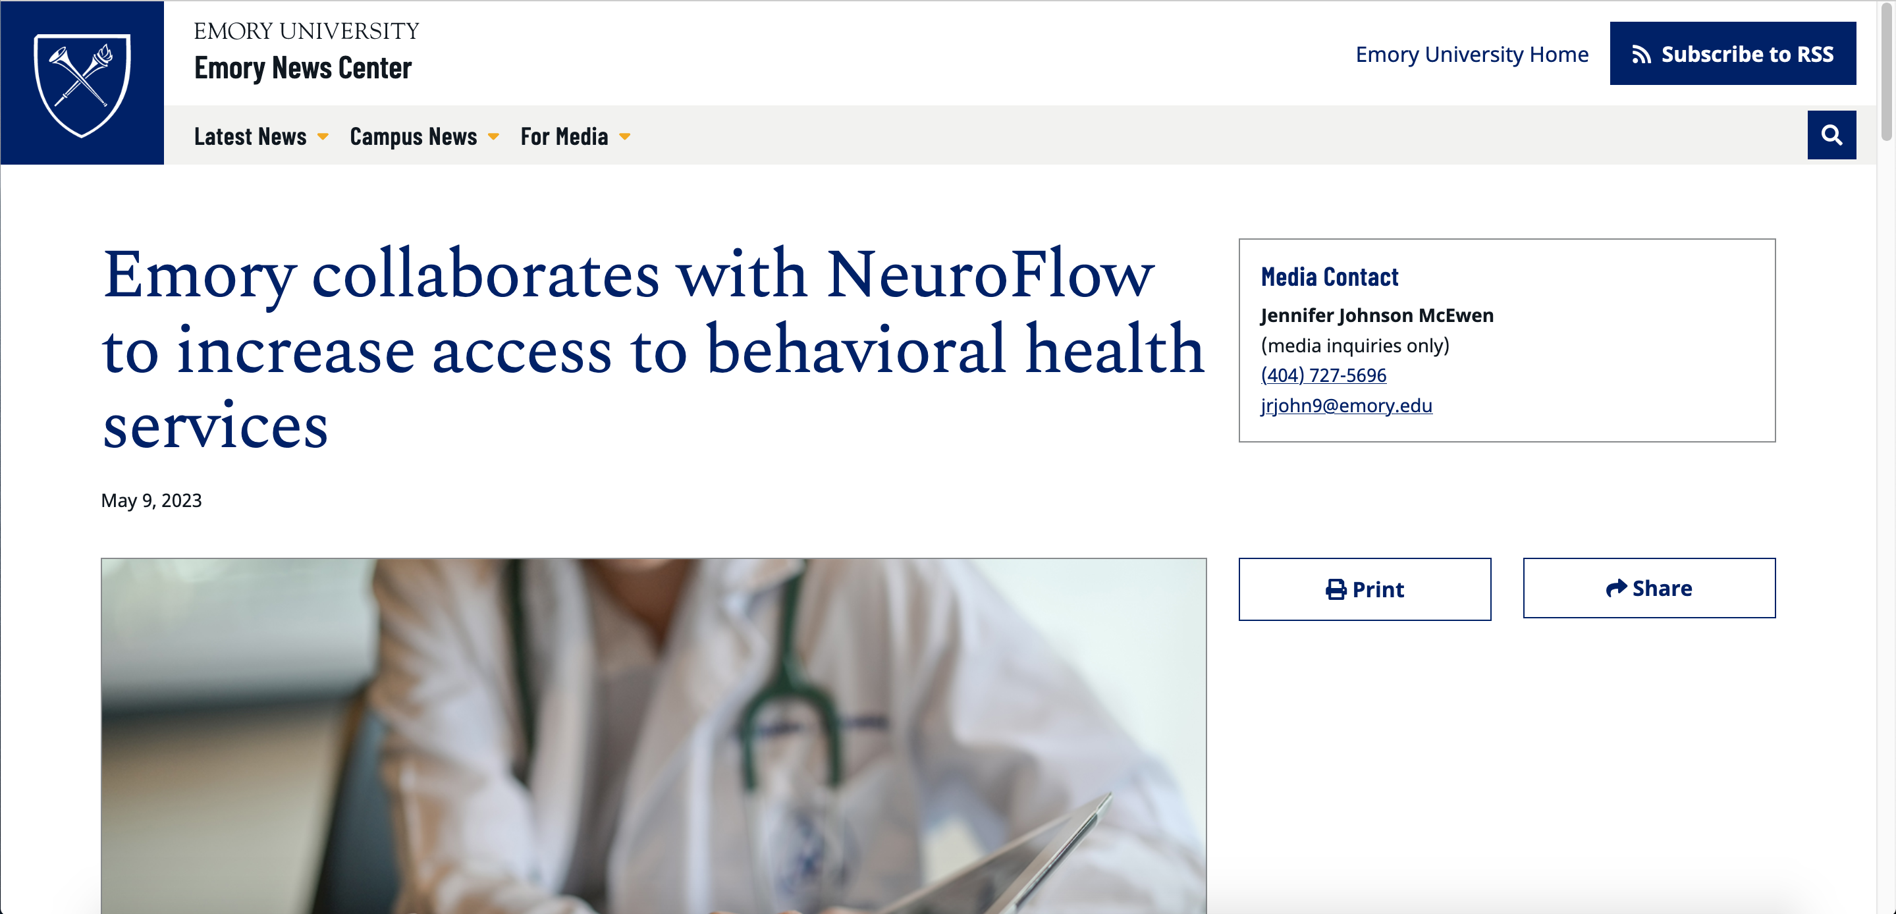
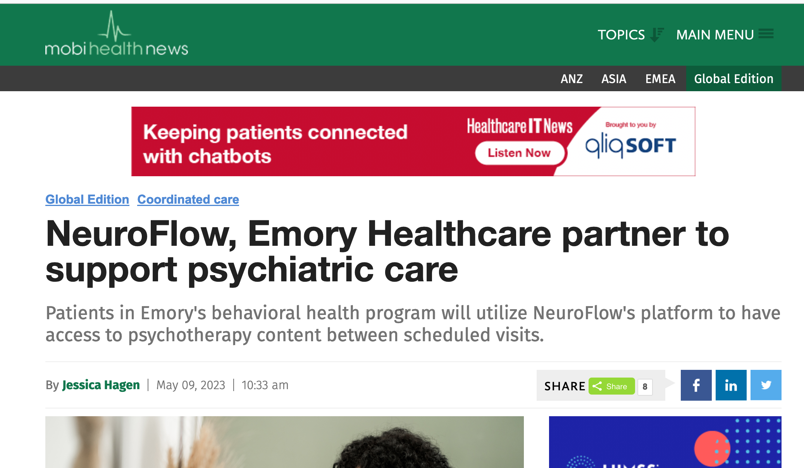

https://news.emory.edu/stories/2023/05/som_bhc_gin_neuroflow/story.html

Slide 42
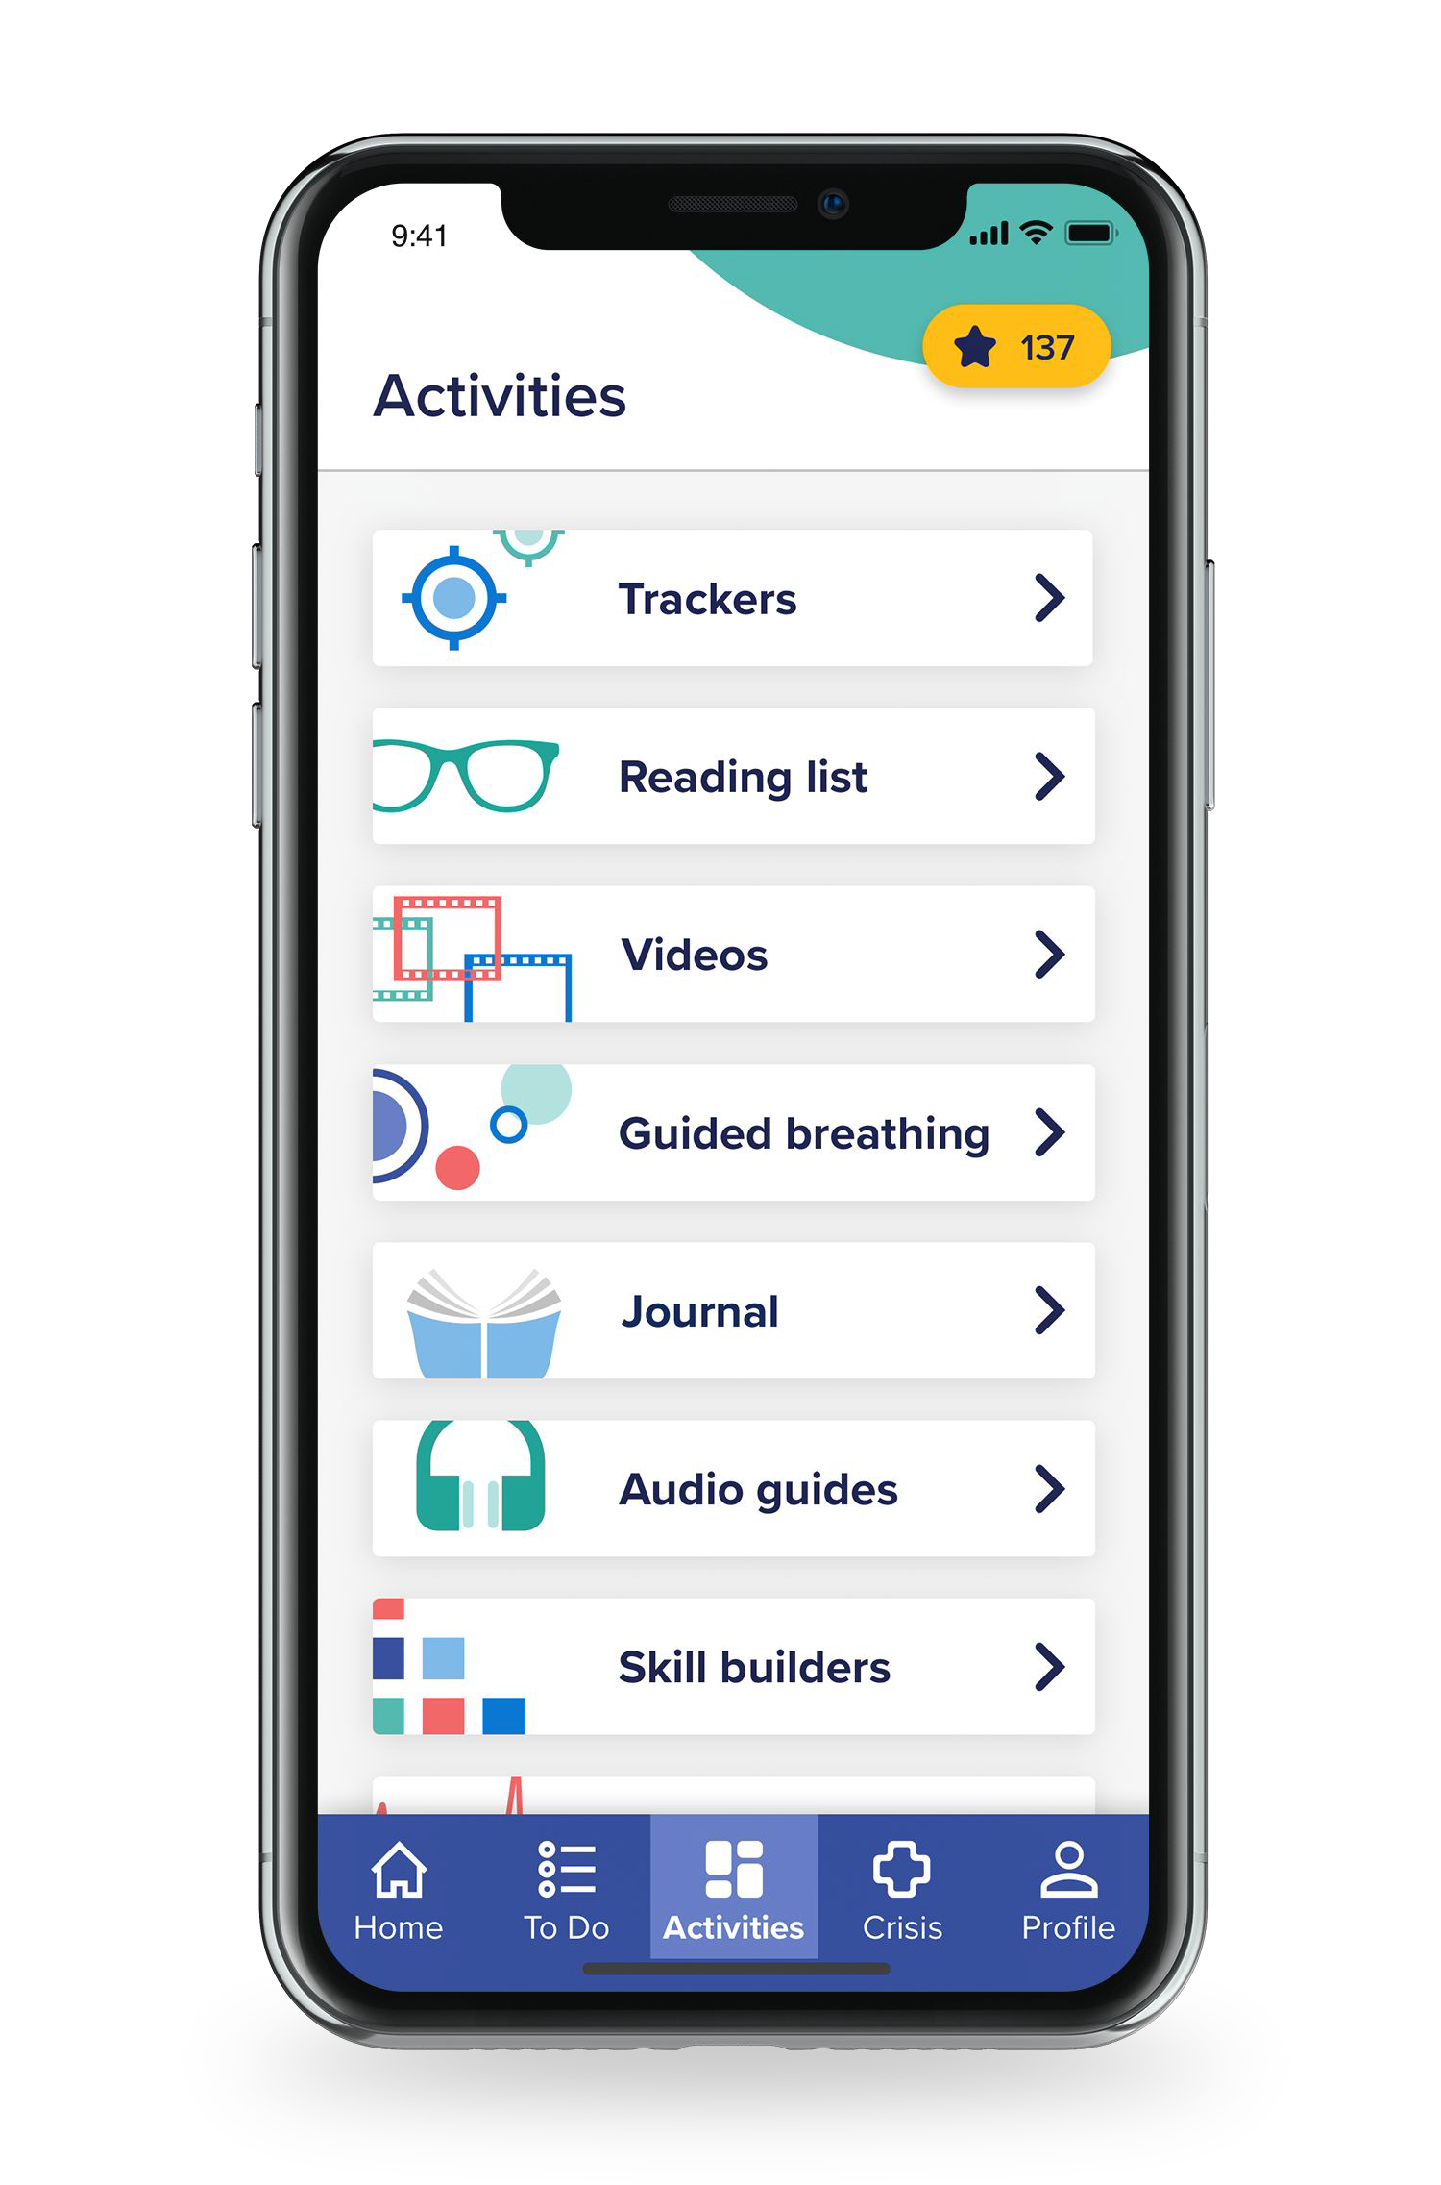
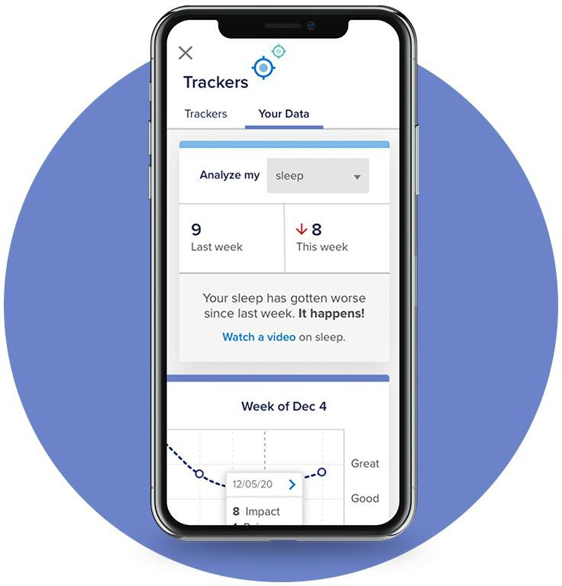
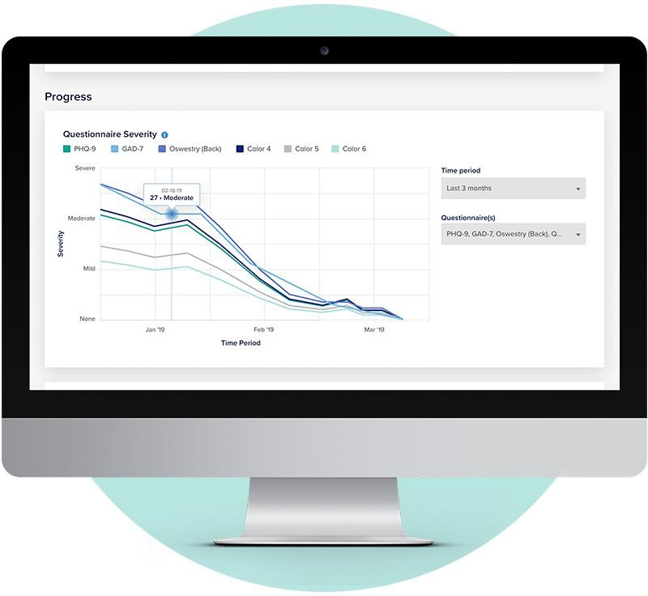
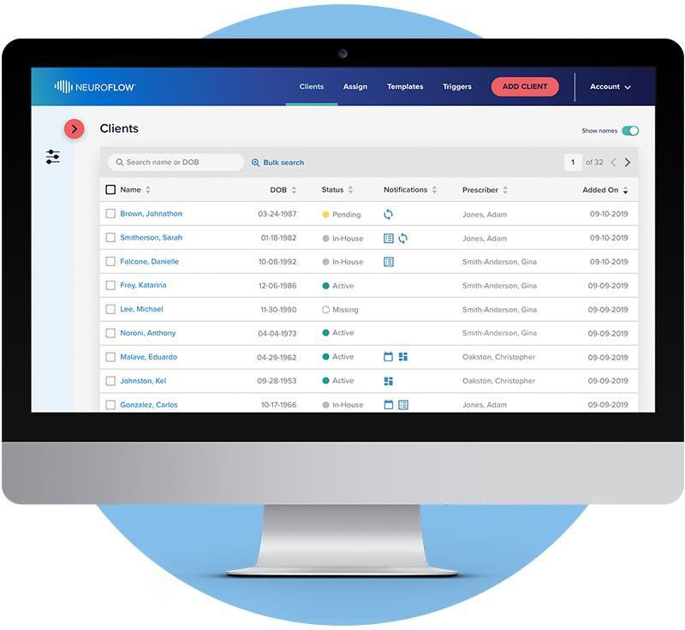
Neuroflow – A Collaborative Care mHealth Platform
Next-Generation Consumer Activation
Patient Facing Ux
Secure, Accessible Measurement Based Care
Data Visualization and Triage
Integrated, Seamless Collaboration
EMR Integrated Registry

Slide 43
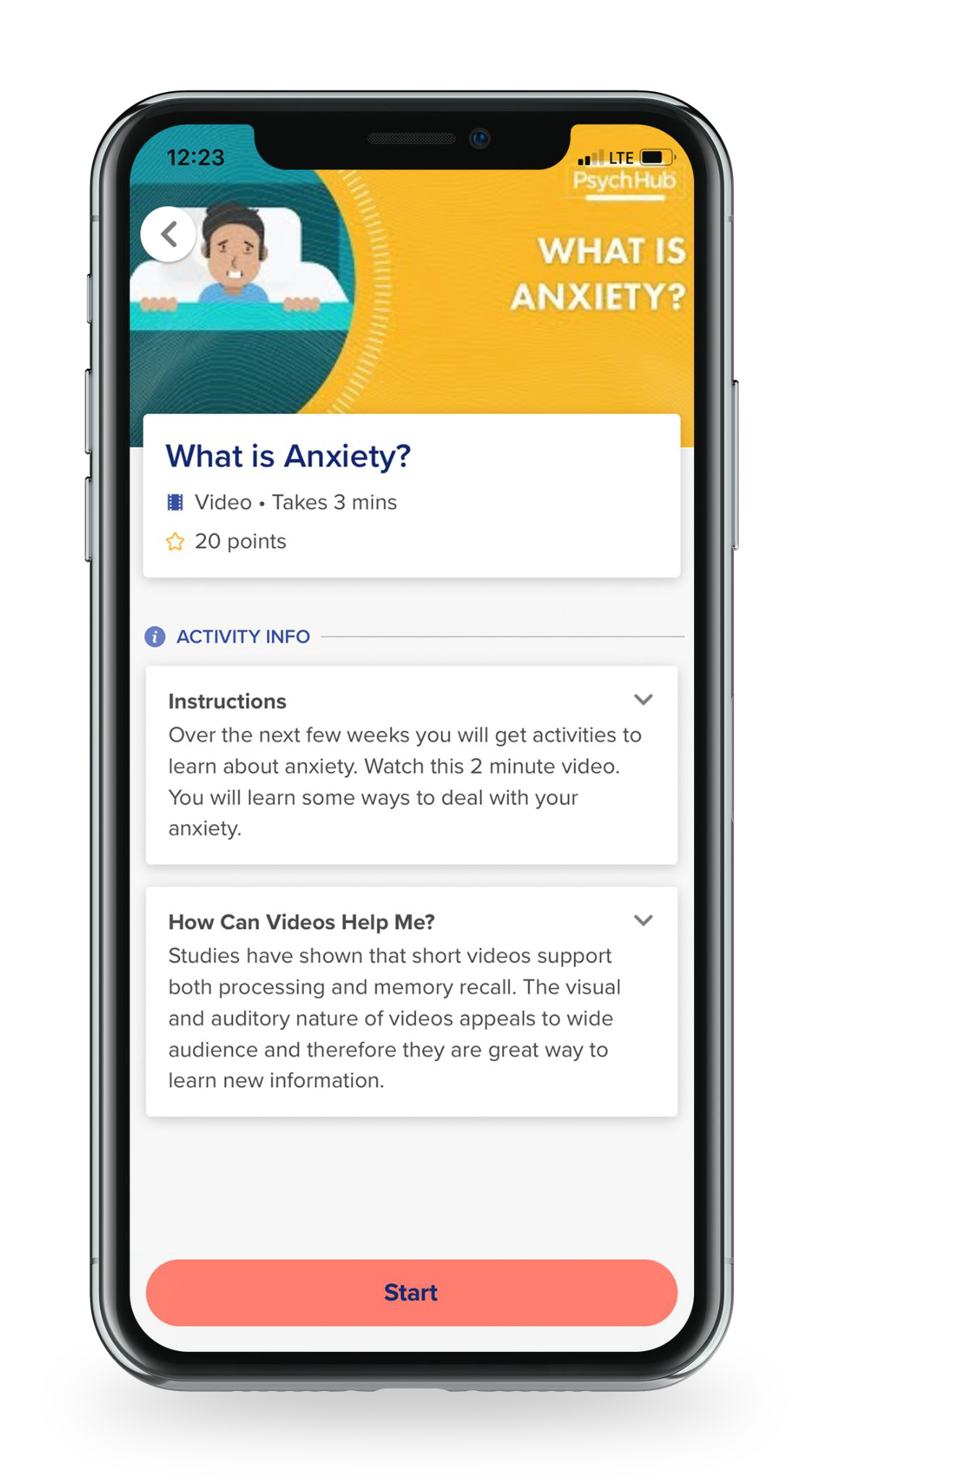
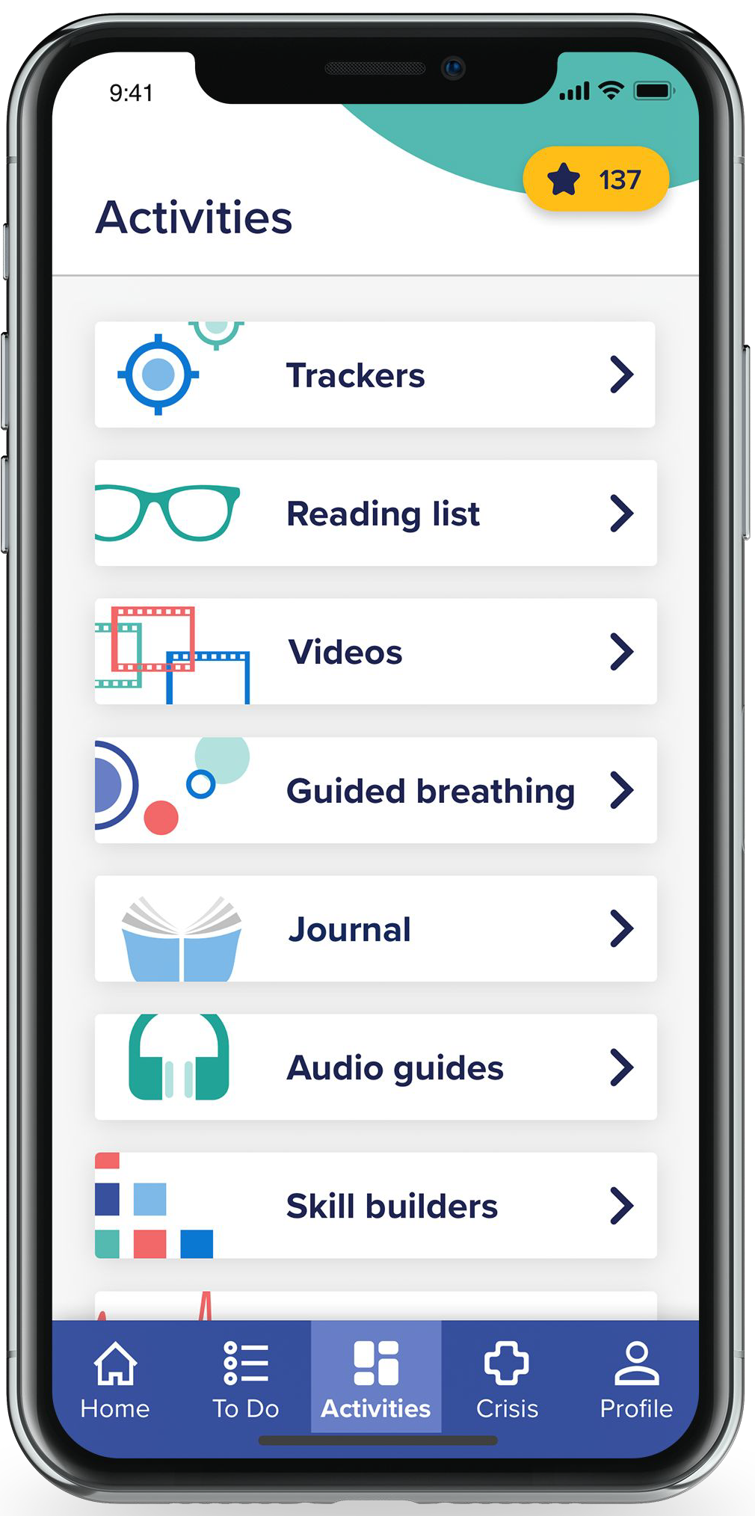
Personalized Patient Content and Resources
Assessments are customizable and delivered at set
cadences
Scoring data + AI automatically trigger appropriate curriculum
for the patient
Users with low risk scores
receive resilience and positive psychology content
Moderate to high scores trigger delivery of condition speciﬁc curriculum for:
Anxiety Disorders
ADHD
Chronic Pain
Depressive Disorders
PTSD
Sleep Disorders
Substance Use Disorders
And more
Crisis resources are organization speciﬁc and prominent in the app
Digital CBT – library of Neuroflow content and opportunity to host unique Emory University developed content
Ability to assign activities, track progress, provide feedback between office sessions (billable), and link progress through content to psychometrics
Behavioral economics – Gamification (e.g. task completion → points → monthly gift cards) enhances engagement

Slide 44


Neuroflow App – Sample Patient Experience
Automated New Client Enrollment
Automatically receives content related to the prevention and management of depression and the following assessments: PHQ 2/9 (depression), GAD-2/7 (anxiety), UCLA 3 (loneliness)
Trigger:
Worsening score on PHQ-9 (depression assessment)
Determined:
NeuroFlow provides an “at-risk” alert to the care team
Your Patient
Larry Finesky, 41
Template Auto-Assigned:
Depression 101 Assignments
(1) Video: Intro to Depression 101 (2) Video: Depression education
(3) Journal: Focusing on the positive (4) SMART goal setting
(5) Journal: Self-compassion (6) PDF: Treatment options
(7) Journal: Goal check-in (8) Video: Behavioral activation
(9) Journal: Behavioral activation (10) Video: Psychoeducation
(11) Video: Depression 101 recap (12) Journal: Goal check-in
Aug
PHQ
Low
Sep
PHQ
Mild
Oct
PHQ
Moderate

Slide 45
Neuroflow at EHC, a phased pilot
PHASE 1: Implementation feasibility pilot, Emory at Midtown Primary Care
Primary Outcome: Effectively enroll and engage 50 primary care patients referred for CoCM in NeuroFlow
Secondary Outcomes:
- Patient/provider satisfaction (qualitative)
- Behavioral health and physical co-morbidity outcomes
- Healthcare utilization

Slide 46
Neuroflow at EHC, a phased pilot
PHASE 2:
- Whole-population NeuroFlow access at Emory at Midtown as a “low-intensity” intervention and triage mechanism to direct Behavioral Health Care Manager (BHCM) support
Primary Outcome: Improvement in clinical outcomes (depression and anxiety) prior to engagement with a Behavioral Health Care Manager (BHCM), e.g. NeuroFlow “lead-in”
Secondary Outcomes:
- Patient/provider satisfaction (qualitative)
- Behavioral health and physical co-morbidity outcomes
- Healthcare utilization, BHCM utilization

Slide 47
Collaborative Care by the Numbers
Clinic | Staff (N) | Patient Population, N = patients | CoCM Start Date | Patients Enrolled in CoCM, Start – March 2023 (Active+Inactive Patients)
Emory at Midtown Primary Care (Internal Medicine) | Faculty physician (10), Internal Medicine residents (28), physician assistants (2), nurse manager, medical assistants, operations administrator | 7,640 (50% Medicare, 5% Medicaid) | Apr. 2021 | 498 (20% Medicare, 13% Medicaid)
Emory at Rockbridge Primary Care and Nephrology (Internal Medicine) | Faculty (1) and non-faculty (3) physicians, Physician Assistants (2), Nurse Manager, Medical Assistants, Operations Administrators | 5,327 (39% Medicare, 2% Medicaid) | Aug. 2022 | 131 (17% Medicare)
Emory at St. Joseph’s Primary Care (Internal Medicine) | Non-faculty physicians (8), nurse manager, medical assistants, operations administrators | 13,207 (48% Medicare, 1% Medicaid) | Sept. 2021 | 225 (28% Medicare)
Emory at Dunwoody Family Medicine | Faculty (12), Family Medicine residents (30), nurse manager, medical assistants, operations administrators | 10,771 (29% Medicare, 20% Medicaid) | Oct. 2021 | 283 (15% Medicare, 20% Medicaid)
Totals |  | 36,945 |  | 1,137
Notes:
Supplemental Table 1. Characteristics of the four EHC primary care clinics that have established the Collaborative Care Model (CoCM) for enhanced delivery of behavioral health services. This includes an embedded “Behavioral Health Care Manager” (BHCM) who performs a psychiatric assessment, determines eligibility for CoCM, provides brief psychotherapy interventions, monitors for symptomatic improvement/medication adherence and tolerance, maintains a CoCM registry, and liaises between patient, Primary Care Clinician (PCP) and Psychiatric Consultant. To date, our program has enrolled 1,137 patients in the CoCM from a population of 36,945 registered primary care patients across four clinical populations.

Slide 48
Collaborative Care by the Numbers
First time engagement with a behavioral health resource for at least 75% of patients
2. ~31% depression response rate/~32% anxiety improvement rate
3. FY2023, Sept. - Mar.: Charged ~$950K in CoCM services
4. Since Epic rollout, completed 11,227 screens for Opioid Use Disorder (47% of patients with one Primary Care encounter)
Notes:
Supplemental Table 1. Characteristics of the four EHC primary care clinics that have established the Collaborative Care Model (CoCM) for enhanced delivery of behavioral health services. This includes an embedded “Behavioral Health Care Manager” (BHCM) who performs a psychiatric assessment, determines eligibility for CoCM, provides brief psychotherapy interventions, monitors for symptomatic improvement/medication adherence and tolerance, maintains a CoCM registry, and liaises between patient, Primary Care Clinician (PCP) and Psychiatric Consultant. To date, our program has enrolled 1,137 patients in the CoCM from a population of 36,945 registered primary care patients across four clinical populations.

Slide 49
Integrated Behavioral Health: What’s next?
Optimize:
- Workflows,
- Patient outcomes
- Charges : Reimbursements
Scale [vertical and horizontal]:
- CoCM for Palliative Medicine
- Technology to expand case load volumes
- Bring on-site CoCM to more clinics, pilot “virtual” CoCM
Connect the dots:
- Develop partnerships for “higher level of care” referrals
- Community engagement, national and statewide lobbying efforts
4. Innovate:
- CoCM for suicide prevention in primary care
- Digital technology dissemination, integration, and comparison of outcomes

Slide 50


FACULTY STAFF ASSISTANCE PROGRAM
Self-care and Overview of Services
Mellonie Hayes Mullins, PH.D, LMFT
FSAP Education Coordinator

Slide 51
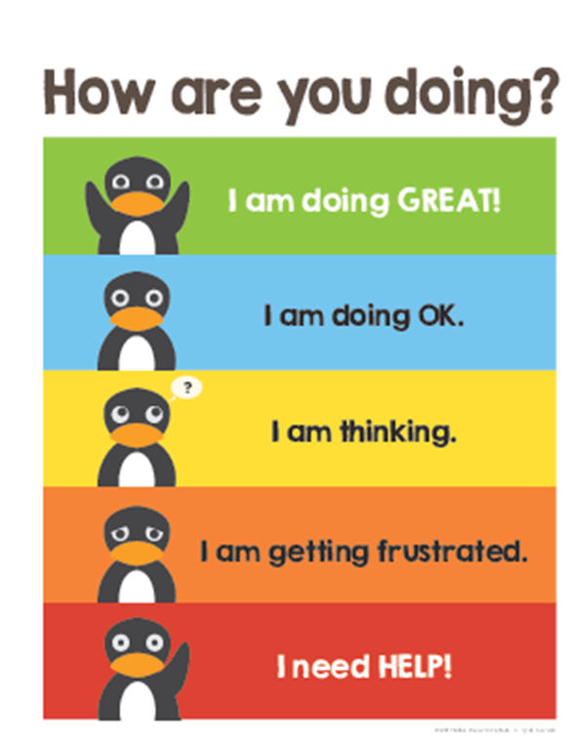
How are you doing on a scale of
1 to 10?
Notes:
Knowing how complex our lives can be, It is important to check-in with yourself regularly- "How am I feeling in mind, body, and spirit?, Do I need anything? Do I want anything? It is also important to be aware of when you are getting into a rough place and need some support.

Slide 52

Notes:
Here’s another way to think about self-care. Do I know when I am depleted? Do I make efforts to recharge my mind, body, and spirit throughout the day?

Slide 53
Community Resiliency Model (CRM)
(Miller-Karis, 2015)
4
Public mental health intervention
Education and mindfulness skills-based
Evidence base multiple populations (Grabbe)
Comprehensive view and principles:
- Optimal psychological and life functioning
- Managing oneself and environment

Slide 54
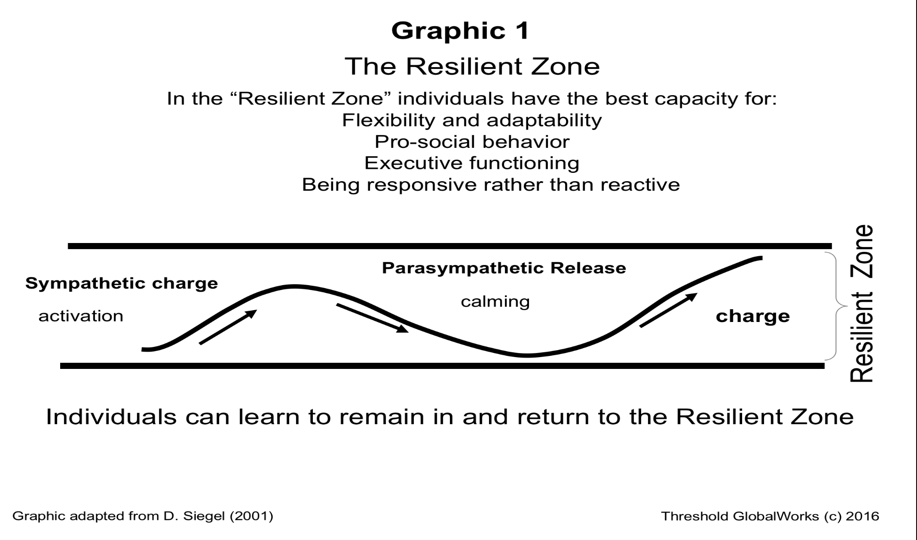
4

Slide 55
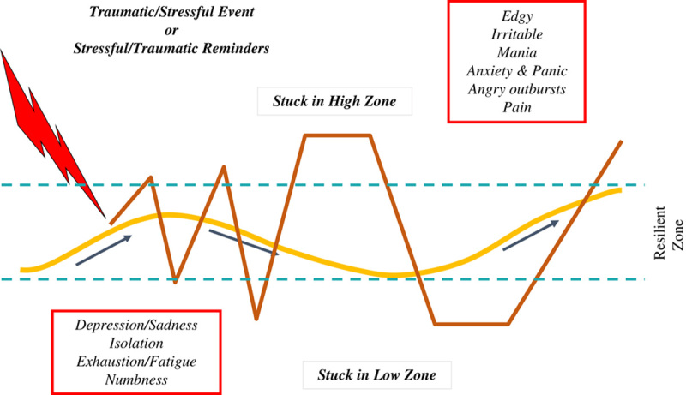
Understanding Stress & Resilience
4

Slide 56
Adopting a Resilience Approach
4
Advantages
    Applicable to all actions, thoughts and speech
    Within personal control
4 Strategies
    Care for the body
    Create positive emotions
    Embrace healthy thoughts
    Stay connected

Slide 57
Self-Care and Well-being
Self- Compassion
Self-Compassion
Being kind and understanding towards oneself during instances of failure, rather than being harsh or self-critical, and recognizing that one’s own experience of imperfection is a part of the human experience (Neff, 2003, p.10).
Self-compassion is one of the strongest predictors of both personal & professional self-care (Miller et. al., 2019)

Slide 58
Self-care and Well-being
Your Sphere of Influence
4
Boundary setting
  Acknowledging and operating within your abilities and limitations
  Operating within those abilities and limitations effectively
Schedule Management
  Staying flexible
  Prioritizing hourly as needs change
  Being mindful about energy management

Slide 59
PREVENTATIVE SERVICES
Well-being Check-ins
Individual check-ins to assess emotional coping and identify strategies for enhancing resilience
Online Self-Screening Tools
Online Self-Screening tools to better understand needs for emotional support (free and anonymous)
Call 404-727-9355 (WELL) or visit www.fsap.emory.edu to access services.
Notes:
These 2 offerings are great opportunities to engage with FSAP in an easy, approachable ways. This may be less overwhelming for some people rather than starting with counseling or coaching services.
The WBCI is offered to all faculty & staff and is a great way to maintain self-care or improve your coping practices. You will complete an online assessment, have a 1-to-1 meeting to discuss the results, and walk away with a plan for self-care.
The online self-screening tools can help you develop insight about what may be happening and gives you are reference point to start a conversation with your FSAP clinician. The results do not come to FSAP.

Slide 60
COUNSELING, COACHING & CONSULTAITONS
FREE Virtual Services:
  Comprehensive Assessments (personal and work-related issues)
  Short-term Counseling (individual, couples, family) – up to 8 sessions; now seeing pre-teens/teens (age 11 and up);
  Individual Coaching (stress, anger, conflict, communication, parental)
  Community Referrals and Case Management
  Crisis Intervention: Daytime and after-hours emergency on-call services 24/7
  Evening Appointment Hours (Monday – Thursday)

Slide 61
REFERRING SELF TO FSAP
Accept that asking for help is OKAY!
Call FSAP’s main number: 404.727.WELL (9355) or email FSAP at efsap@emory.edu.
Share that you are an Emory employee, what type of assistance you are seeking, and any preferences such as date/time and gender/ethnicity of FSAP provider.
Emory policy allows employees to utilize FSAP (short-term) during work hours, as long as, coverage is adequate.

Slide 62

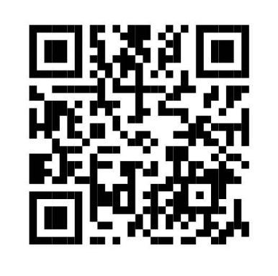
HOW TO CONTACT FSAP & LEARN MORE
Phone: 404-727-WELL (9355)*
FSAP Email: efsap@emory.edu
Website: www.fsap.emory.edu
FSAP Listserv: FSAP-L@listserv.cc.emory.edu
*After hours, if in crisis, press 2 for Answering Service
Notes:
I will give everybody a few moments to capture the QR code that takes you directly to our website, so that you can review it at a later time. You will already have the site in your browser for easy access.
You have a variety of ways to get in contact with us. 1 easy way to stay current with what we are offering is to join the FSAP Listserv. Please notify the facilitator of this meeting (your contact person for this overview) and they will update me with the list of names to add to the listserv.

Slide 63
Emory OnCore
OnCore and Epic Updates
RESEARCH MATTERS
June 15, 2023

Slide 64
Wedding Date: 10/1/2022
Holistic view of a subject-patient record
OnCore
Emory University Clinical Trials Management System
Epic
Emory Healthcare Medical Records System
Billable Items at EHC or Grady facility
NIH clinical trial studies
Studies with Invoiceables
Winship studies
Optional Studies – no billables; subject entry only

Slide 65
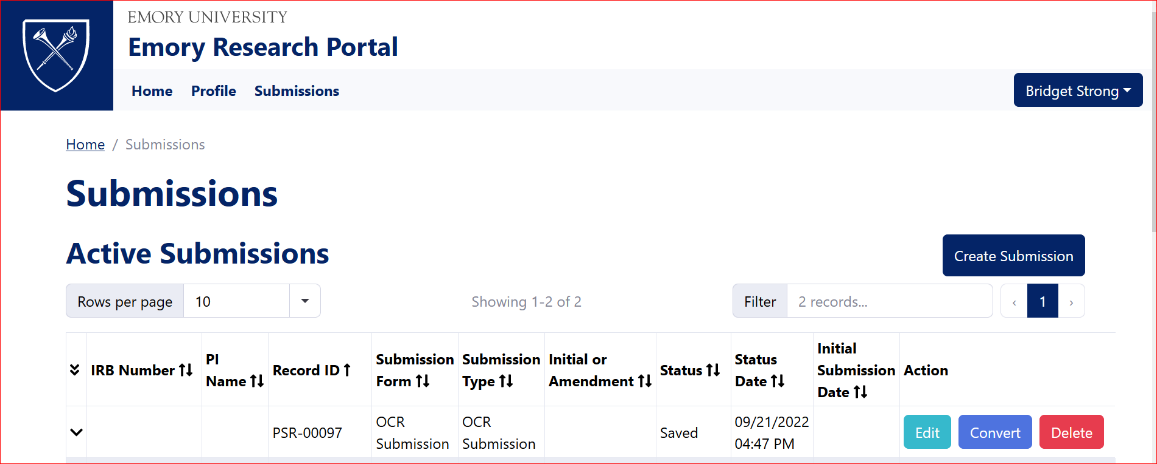
Study Submission
New Pre-Study Submission App
  Replaces the OCR Submission Form – paper format
  Electronic Emory Research Portal for new, amendment, CRKP, EML, and Radiology
  Release date: Monday, June 26th

Slide 66
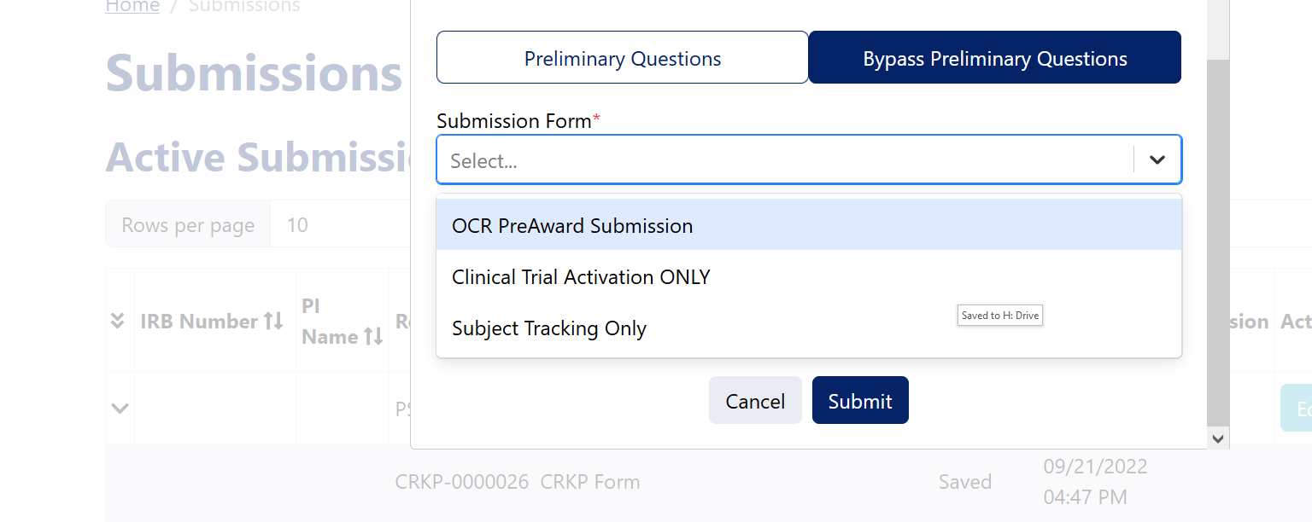
Study Submission
New Pre-Study Submission App
  3 types of submissions: OCR PreAward, CT Activation Only – formerly ERMS Activation Form, and Subject Tracking Only.
  Communication will be provided next week on link location, user guide, resources, etc., via OCR/CTO Announcement& Clinical Investigator Listservs.

Slide 67
OnCore Invoicing
OCR Invoicing and IT have worked together to interface OnCore and ERMS Administrative Database to produce invoices for OnCore-tracked activities.
What’s Next: Testing is ongoing for the interface and next month invoicing will resume for OnCore-tracked activities.
  All SOTs (Summary of Transactions) and Invoices will be uploaded to OnCore every month after the study review.
  Please allow 30-60 days for all invoices to be reconciled.
Communication will be sent out via the OCR/CTO Announcements and Clinical Investigators listservs on where to find the SOTs and Invoices.

Slide 68
OnCore Training Updates
New OnCore Training will change from 1-day to 3-day training.
  Training every other Tuesday from 9:00 am – 1:00 pm via Zoom, but would move to the following schedule starting this Summer:
    Monday (2hrs.) – Introduction to OnCore, PC Console
    Tuesday (4 hrs.) – CRA Console, Subject Console
    Wednesday (2 hrs.) – Financial Console, and CTBD Billing
    Refreshers (Online) – renewal for expirations, starting September 2023
New OnCore & Epic Interface Training for Research
  Curriculum will involve Linking Encounters/Timeline, Remote Monitoring, Billing, and Study Closeout
  Starting this,Summer; communication coming …

Slide 69


OnCore Updates
Every Wednesday, 12:00 – 2: 00 pm
Ask your questions, get answers immediately!
https://emory.zoom.us/j/92109146964
Visit the OnCore SharePoint site announcements, training, and remote monitoring information.
https://emory.sharepoint.com/sites/OnCore

Slide 70
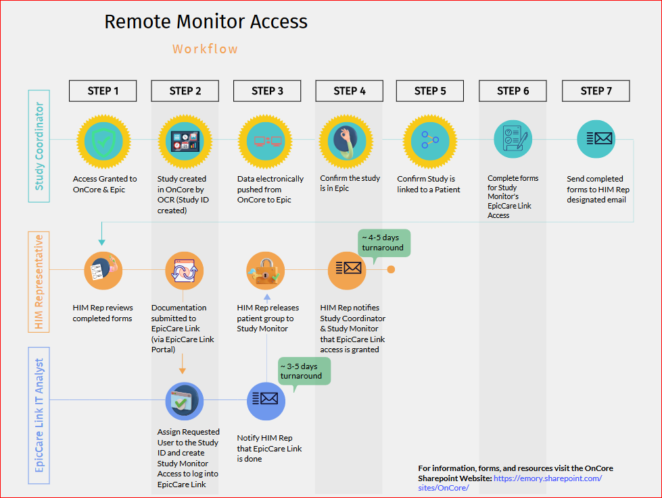
Remote Monitoring
Workflow

Slide 71

Questions?

Slide 72
Thank You!

Slide 73
Accreditation Statement
The Emory University School of Medicine is accredited by the Accreditation Council for Continuing Medical Education (ACCME) to provide continuing medical education for physicians.
Physician designation statement
The Emory University School of Medicine designates this live activity for a maximum of 1.5 AMA PRA Category 1 Credit(s)™. Physicians should claim only the credit commensurate with the extent of their participation in the activity.

Slide 74
Research Matters
Virtual - Zoom
June 15, 2023
DISCLOSURE STATEMENT
In accordance with the ACCME Standards for integrity and independence in Accredited Continuing Education, all relevant financial relationships, and the absence of relevant financial relationships, must be disclosed to learners for all individuals in control of content:
Before learners engage with the accredited education
In a format that can be verified at the time of accreditation
The following individuals have reported relationships with ineligible companies, as defined by the ACCME. Ineligible companies are those whose primary business is producing, marketing, selling, re-selling, or distributing healthcare products used by or on patients. These relationships, in the context of their involvement in the CME activity, could be perceived by some as a real or apparent conflict of interest. All relevant financial relationships have been mitigated to ensure that no commercial bias has been inserted into the educational content.
See table next slide
All remaining individuals (planners and/or speakers) with control over content have no relevant financial relationships with ineligible companies to disclose.

Slide 75
Speaker Name | Company | Received/Role
Brandon Kitay, MD | Biogen Boehringer Ingelheim Pharmaceuticals Janssen Pharmaceuticals Merck | Consultant Fee / Advisory Board “ “ “ “
No grant support was received for this activity.

Slide 76
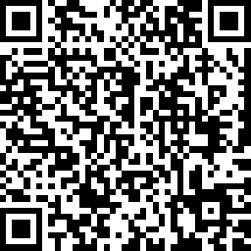
RESEARCH MATTERS
June 15, 2023
Attendance Check - In
https://www.surveymonkey.com/r/V6DCZR6

Slide 77
Closing Remarks
Within a week, the following will be available on
This seminar's recording, PowerPoint presentation, and survey will be available on the OCR’s website within a week at
http://www.ocr.emory.edu/training/research%20matters.html
Attendees can receive 1.5 CMEs/CEUs/Nursing Credits and their certificate will be available after checking in and completing the survey. Please see the QR code provided and an email will be sent to attendees with our survey.
Our next Research Matters educational seminar will be
October 26, 2023.
See you this autumn!!!

