Slide 1
Improving Accuracy of PI-initiated Studies Processed for the ClinicalTrials.Gov Team
Karen Browning &
Chade Granderson
Notes:
Our project is a little different as most covered a clinical process. Ours is related to a research administration process.

Slide 2
background
OCR Mission: The mission of the Office for Clinical Research (OCR) is to facilitate operational processes that support the efforts of the clinical research team in the timely initiation, management and completion of clinical trials at Emory.
Consists of multiple teams managing research activities throughout the study lifecycle.
    Clinical Research Support Services
    Pre-Award
    Education & Outreach
    Data Integrity
    ClinicalTrials.gov.
    Clinical Research Finance Management
Notes:
OCR falls under the Office for research administration and handles a number of research activities throughout the lifecycle of a study. This includes the review of all new protocols submitted to the IRB and the registration of certain studies in the ClinicalTrials.gov.

Slide 3
Background
ClinicalTrials.gov – website requiring registration and results submission of specific clinical trials in adherence to federal regulations & policies.
Emory Office for Clinical Research (OCR) registers and monitors study records on principal investigator’s (PI) behalf.
PI-initiated studies submitted through the OCR submission process must be identified and notification sent to the ClinicalTrials.gov team.
Without notification, unnecessary entry delays into ClinicalTrials.gov may occur.
Lack of registration or delay may result in federal penalties (up to $10,000 per day, NIH loss of funding, etc.).
Notes:
PI initiated studies are those for which an investigator is the study sponsor. Studies are reviewed for registration applicability into CT.gov. The rule is to have registration complete within 21 days of the first subject consent, but we strive to have it registered prior to any subject signing consent.

Slide 4
baseline conditions
Notification of PI-initiated studies first received by OCR Pre-Award Team should be sent to the ClinicalTrials.gov Team for subsequent review.
Study registration may be delayed when notification of a PI-initiated study is not forwarded to the ClinicalTrials.gov team.
Pre-Award Team Lead reviews protocol
Pre-Award Team Lead makes PI-initiated study determination
Lead CRFM enters data into OCR log and notifies ClinicalTrials.gov team
ClinicalTrials.gov team reviews study and makes registration determination
Pre-Award Team Lead requests entry in OCR log to Lead CRFM

Slide 5
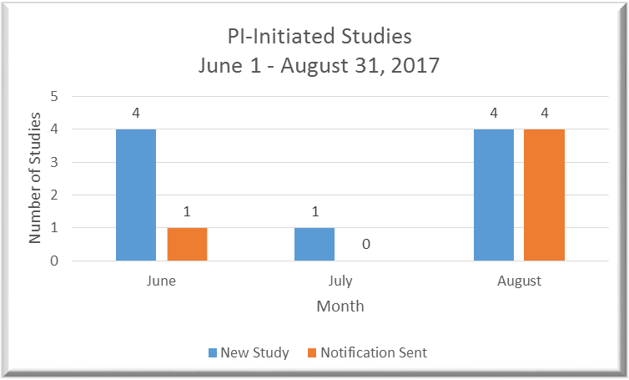
Baseline conditions
Notes:
Data comes from the OCR log which is a database housing all information related to a study. Although the number of PI-initiated studies seems low, the penalties and consequences for not registering a study can be very costly.

Slide 6
Goal: Aim statement
Attainment of accuracy for the processing of PI-initiated studies by the Pre-Award team at 100% reliability by November 1, 2017.

Slide 7
Problem analysis

Slide 8
New Process Flow
Pre-Award Supervisor will email the ClinicalTrials.gov Team when PI-initiated study is received.
As a double check, a Clinical Research Finance Manager on the Pre-Award Team will ensure that ClinicalTrials.gov Team has received the notification.
Pre-Award Supervisor reviews protocol
Pre-Award Supervisor makes PI-initiated study determination
Pre-Award Supervisor sends notification to ClinicalTrials.gov Team
CRFM, Sr. enters data into OCR log
ClinicalTrials.gov Team reviews study and makes registration determination

Slide 9
Countermeasures
Action/Test of Change | Outcome/What was Learned?
The Pre-Award Team will send an email as notification to the ClinicalTrials.gov team alerting them of a PI-Initiated study. | Since September 9, 2017 to October 31, 2017 the ClinicalTrials.gov team has received notification of all PI-Initiated studies that have been received by the OCR Pre-Award.
 | Better communication between the Pre-Award and ClinicalTrials.gov teams has contributed to the reduction of study entry delays into the ClinicalTrials.gov website.
 | The test of change acknowledged a reduction with the inconsistencies and variation by 100%

Slide 10
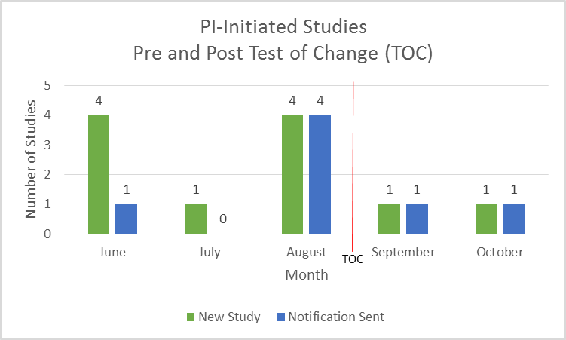
Metrics/results

Slide 11
Follow up/Next steps
Pre-Award will continue to notify ClinicalTrials.gov team to ensure reviews are consistent and complete.
Continue to run a quarterly report in OCR database to ensure no studies are missed.
Future projects may be developed as all databases move into the Emory Research Management System (ERMS) to streamline the process.

