Slide 1
New reporting structure: Unrealized Revenue
Marcha Gatewood
Charlie Stembridge
Emory University
Office for Clinical Research

Slide 2
Team members
Name | Role
Robin Ginn, RN, MBA, CHC, CHRC, CIP | Asst VP, Resch Adm/Ex Dir, OCR, Office for Clinical Research
Sherry Coleman, DNP, RN, CHRC | Asc. Exec Dir, Clinical Trials, Office for Clinical Research
Bridget Strong, MBA,CCRP | Director, Education and Outreach (Project Liaison)
Wenona Favors, MBA, CCRP | Supervisor of Clinical Research Accounts (Advisor)
Veronique King | Supervisor of Clinical Research Accounts (Advisor)
CRCAC committee members | Survey response/feedback
Research Administration Services (RAS) units | Survey response/feedback

Slide 3
Ocr: Mission
The mission of the Office for Clinical Research (OCR) is to facilitate operational processes that support the efforts of the clinical research team in the timely initiation, management and completion of clinical trials at Emory.

Slide 4
Background
The OCR Invoicing Team provides financial management services for Industry sponsored clinical trials to the entire School of Medicine.
The Statement of Transactions (SOT) was initially created for OCR Invoicing internal reporting purposes only.
Report may have been utilized in ways that negatively impact the study budget account.
Lack of clarity and understanding have made it difficult to report outstanding funds to researchers and research administration departments.
Unrealized revenue on report does not only consist of outstanding funds, but
Total payments received, not itemized to the invoice(s) and/or patient activity.
Total payments outstanding (Invoices and non-invoiceables).
Withheld amounts per Clinical Trials Agreement.
Emory University
Office for Clinical Research

Slide 5
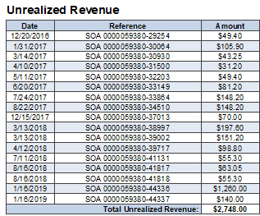
Current (baseline) conditions
Unrealized revenue on SOT report:
Customers and Finance Managers frustrated due to lack of clarity.
Emory University
Office for Clinical Research
Notes:
as you can see, looking at the section of the report doesn't provide you with all those details.

Slide 6
Aim statement
To implement a new report that provides clear and improved financial reporting to the research community.
Provide information that is useful to our customers/end users.
Provide report in real time.
To educate our customers on the use of the information provided on our report.
Emory University
Office for Clinical Research

Slide 7
Goal
Our Goal: new reporting structure/template.
New report implemented and 100% of our customers educated by 9/1/19.
Create an instant report that is accessible to the research community in real time.
Benefit
Improved customer satisfaction (measured by periodic surveys and face to face interviews).
Emory University
Office for Clinical Research

Slide 8
Problem analysis
Data requested from end users Clinical Research Advisory Committee and Research Administration Departments
Survey containing 3 questions:
Please select the information you would like to see on the SOT.
How often would you like to receive the SOT?
If possible, would you like access to an online version of the SOT available in real-time?
Emory University
Office for Clinical Research

Slide 9
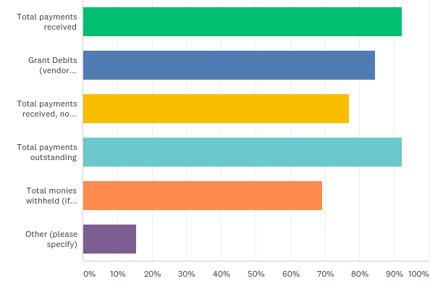
Q1: Please select the information you would like to see on the SOT.
Emory University
Office for Clinical Research

Slide 10
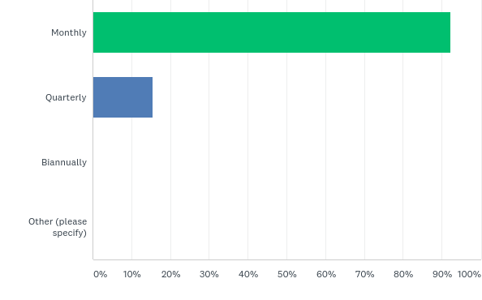
Q2: How often would you like to receive the SOT?
Emory University
Office for Clinical Research

Slide 11
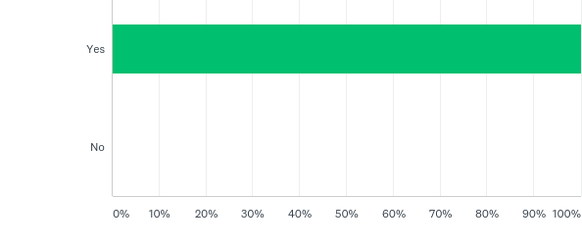
Q3: If possible, would you like access to an online version of the SOT available in real-time?
Emory University
Office for Clinical Research

Slide 12
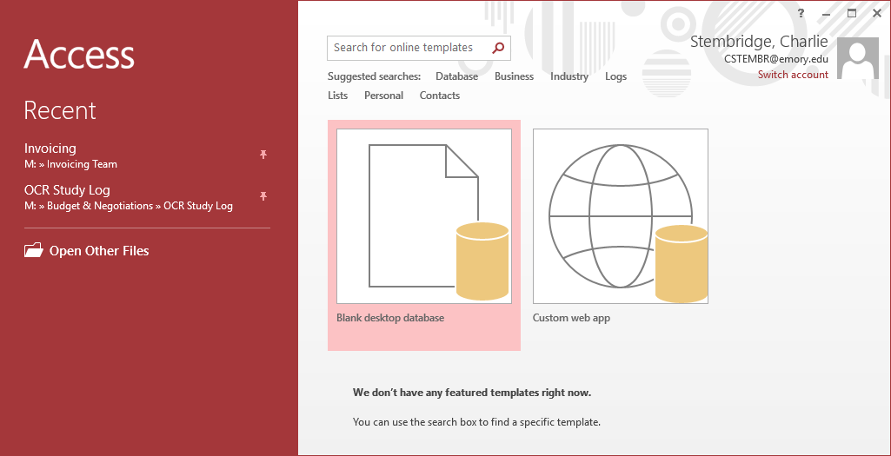
Current Database
Study teams must rely on CRFMs to (re)generate the SOT report.
System is outdated and not user friendly.
Limited capabilities.
Limited data volume.
Outside vendor owned.
Requires hours of overnight data back-up.
All users share same password.
Difficult to track Key Performance Indicators.
Emory University
Office for Clinical Research

Slide 13
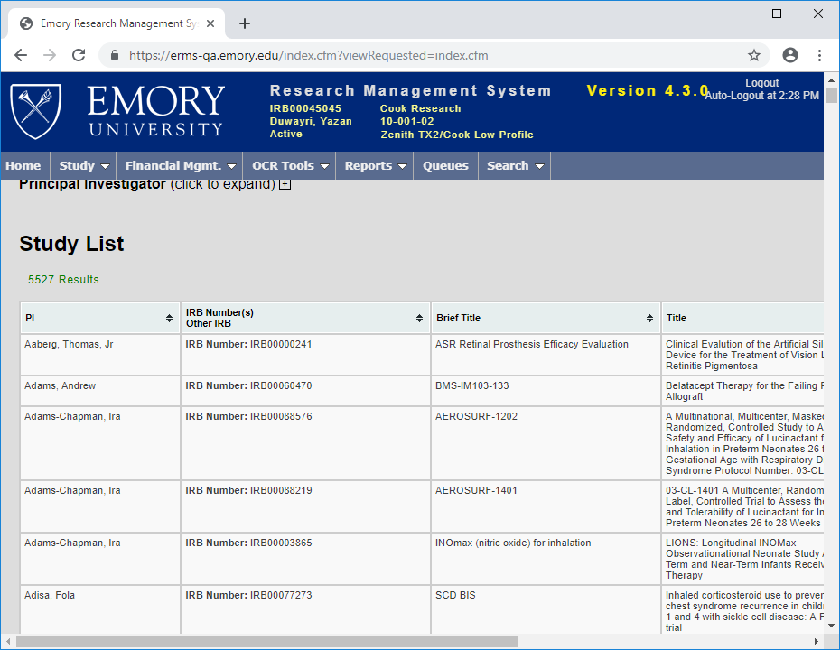
Future Database
User friendly.
Web based system.
Higher data volume.
Emory owned and operated.
Quick overnight data back-up.
Endless capabilities.
Individual passwords.
Easier tracking of Key Performance Indicators.
Emory University
Office for Clinical Research

Slide 14
METHODS:
Once a month reporting
Manual staff process
Variations in the use of report by customers
Technology:
Limited Access Database
No real time reporting
Data retrieval cumbersome
People:
Lack of training
Late reporting
Incorrect SOTs sent to customers
Current SOTs contain information that can potentially have a negative impact on Clinical Trial Awards
Materials:
Sources Include Sponsors, Study teams, Research Administration Departments
Measurement:
Lack of customer satisfaction analysis
Environment:
Lack of communication due to silo mentally
Limited room for error
Emory University
Office for Clinical Research

Slide 15
Countermeasures
Action/Test of change | Hopeful Outcome
Implementing a new report that addresses customer needs. | Improved customer satisfaction.
Moving the invoicing database and reporting platform to a new system. | Providing real time reports.
Educating the research community on analysis of new reports. | Improved understanding of new report → no frustration
Training for new and existing team members. | Improved customer service to the research community.
Sending periodic survey to assess understanding and customer satisfaction. | Continuous improvement.
Emory University
Office for Clinical Research

Slide 16
Follow up/Next steps
Implement new, improved report.
Follow-up survey in September (and quarterly thereafter).
Write Standard Operating Procedure to standardize process of generating reports in new system.
Train end users and provide real time access to report.
Educate study staff on implications of inaccurate tracking (with OCR education team).
Emory University
Office for Clinical Research

Slide 17
Thank YOU!!!
CRCAC members (Survey responses)
RAS teams (Survey responses)
Dr. Nathan Spell III: Quality Academy Training
OCR Leadership: Robin Ginn
OCR invoicing: Sherry Coleman, Veronique King, Wenona Favors and entire team
OCR education: Bridget Strong
Emory University
Office for Clinical Research

