Slide 1
Document Control of the Prospective Reimbursement Analysis (PRA)
Sheila O’Neal and Vickie Swafford

Slide 2
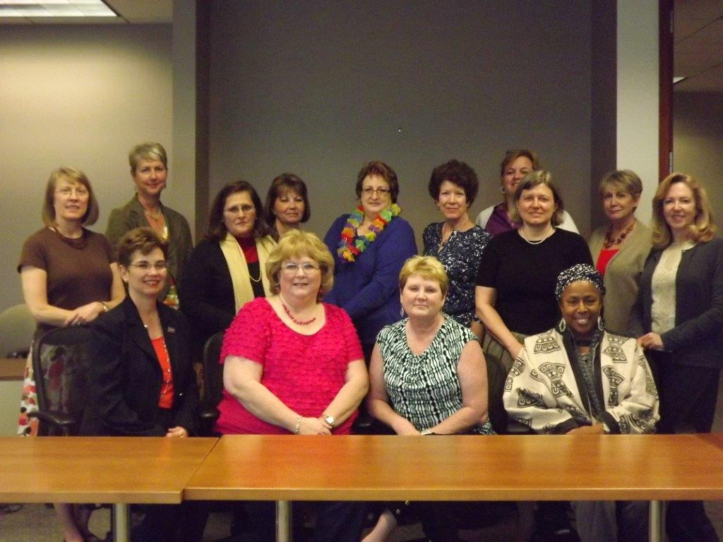
Office for Clinical Research Pre-Award Team

Slide 3
Background
Office for Clinical Research (OCR):
  The OCR was established in 2001 as part of the implementation of the SOM's unfolding strategic plan for research. Addressing patient safety as it revolved around compliance.
  Per the Dean’s Mandate of June 11, 2007 – “The School of Medicine instituted a mandatory policy whereby any new clinical trial or other research study that requires any intervention with a human subject involving drugs, devices, services or procedures must have a coverage analysis completed before it will be approved by the Office of Sponsored Programs (OSP).”

Slide 4
Background
The Prospective Reimbursement Analysis (PRA):
The purpose of the PRA is to identify the appropriate payer for all items/services required in the clinical trial in order to ensure that charges are appropriately covered/allocated and prevent billing errors.
Involves a thorough review of the protocol, draft Clinical Trial Agreement (CTA), draft budget, and draft informed consent document (ICD) in order to reach an objective determination regarding which items, services, etc. required of the protocol can and cannot be billed to third party payers using applicable Medicare guidelines.
The PRA is part of the subjects medical record if they are a patient at Emory Healthcare.

Slide 5
Aim Statement
We will show a >90% accuracy of naming of the final PRA and how it is stored in the OCR share drive by May 3, 2013. The Pre-Award Leads will develop a standard, consistent product – Final PRA document – with a focus on: Title (OCR ID), Footer (naming convention – method), Protocol (version noted on the QCT page) and Folder storage (both the PRA sub-folder and Completed sub-folder) – for use in OCR between Pre-Award and Data Integrity teams.

Slide 6
Initial Data

Slide 7

After reviewing the data we were thinking “what did we step into”.

Slide 8
Tests of Change #1
Test of Change | What was learned?
Met with the Leads who perform the PRA to discuss process & project. Review of Process. Fishbone Diagram was created. Agreements on definitions and standards of process were reached going forward there would be a new process. Created and provided a detailed set of instructions. | No standard process.

Slide 9
PRA Project Definitions
PRA Project | Definition | Criteria
Title Name | OCR ID = IRB#-YR-ACRONYM; consist with original, amendment and revised | IRB#, the year, and acronym Example #1: IRB00012345-13-TESTPRA Example #2: IRB00012345-13-TESTPRA Amendment 2; April 13, 2012 Example #3: IRB00012345-13-TESTPRA Revised March 15, 2013
Footer File Name | OCR ID_FINAL_PRA_mm.dd.yr (example original) OCR ID_FINAL_PRA_Am1_mm.dd.yr (example amendments) OCR ID_FINAL_PRA_V.12.5_mm.dd.yr (example of versions) OCR ID_FINAL_PRA_Rev_mm.dd.yr (example revision) | date=LAST CHANGED DATE
Protocol Version | Use current Protocol version date that is being used to generate the PRA; list all versions/amendments used to change PRA | Use terminology dictated by the sponsor protocol - identical to how it is written on protocol. Example #1: 28 February 2013 Example #2: March 5, 2013 Example #3: 04/15/2013 Example #4: (PI written no date - use E-Date received in OCR log)
PRA Storage | Completed folder for the current project (i.e. original or amendment, etc.); revisions of PRAs should be stored here too. | Finalized PRAs: one Excel and one PDF version should be saved in the COMPLETED folder (original or amendment folder)

Slide 10
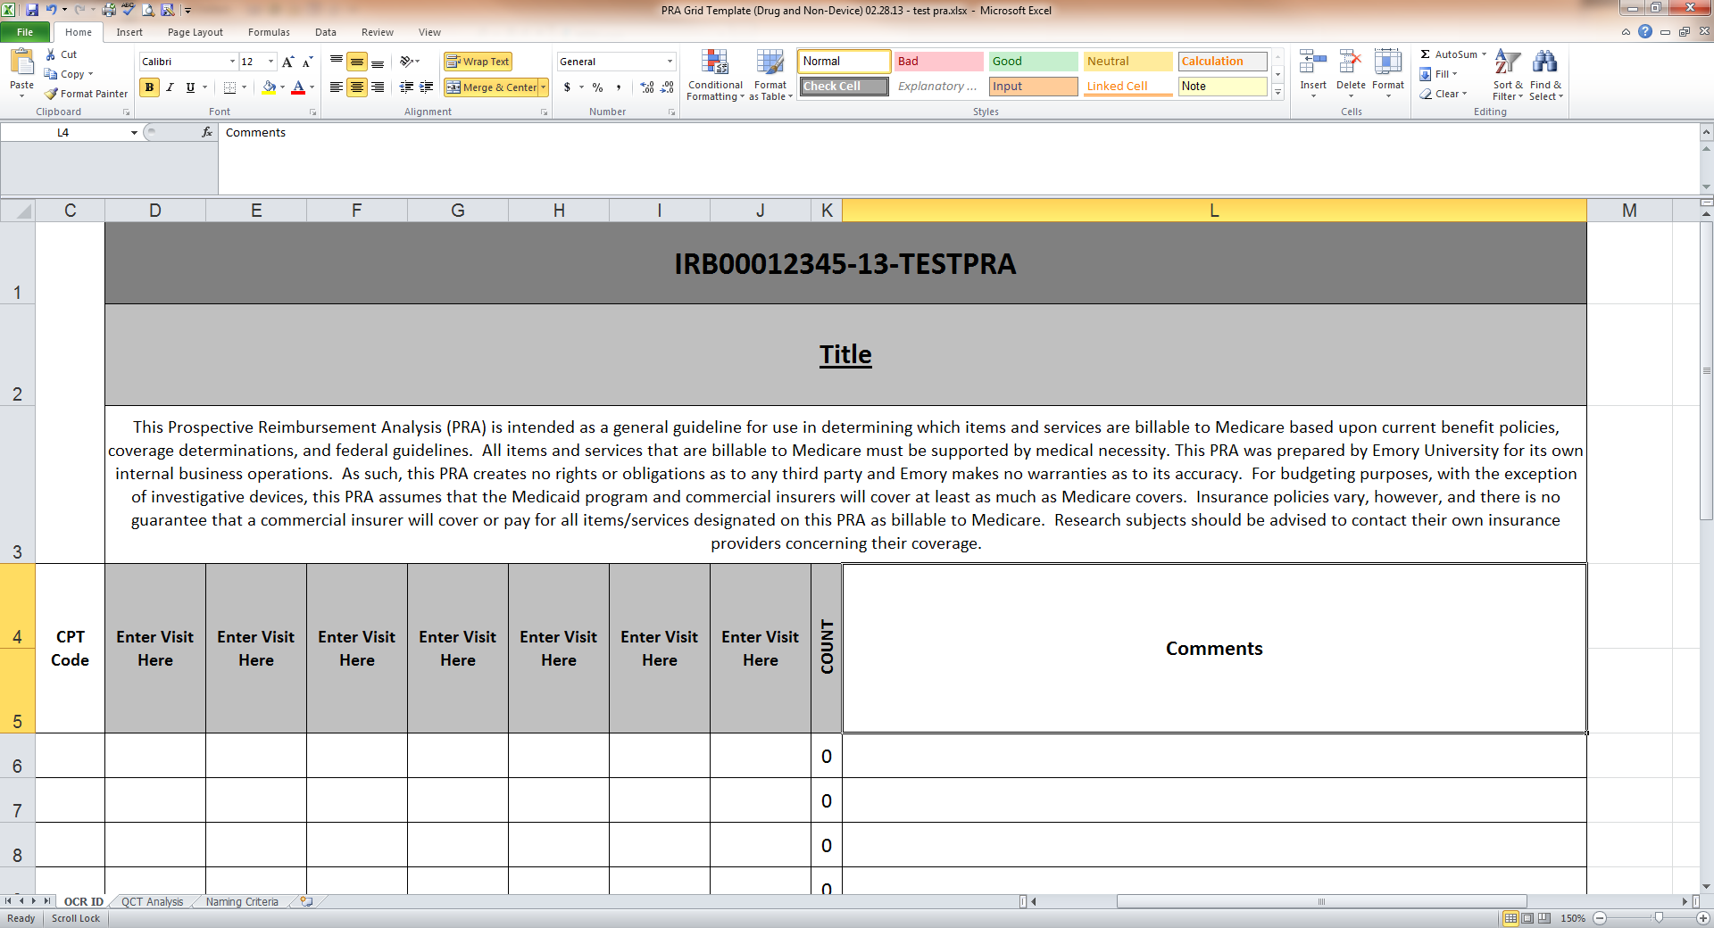
PRA Title Template

Slide 11
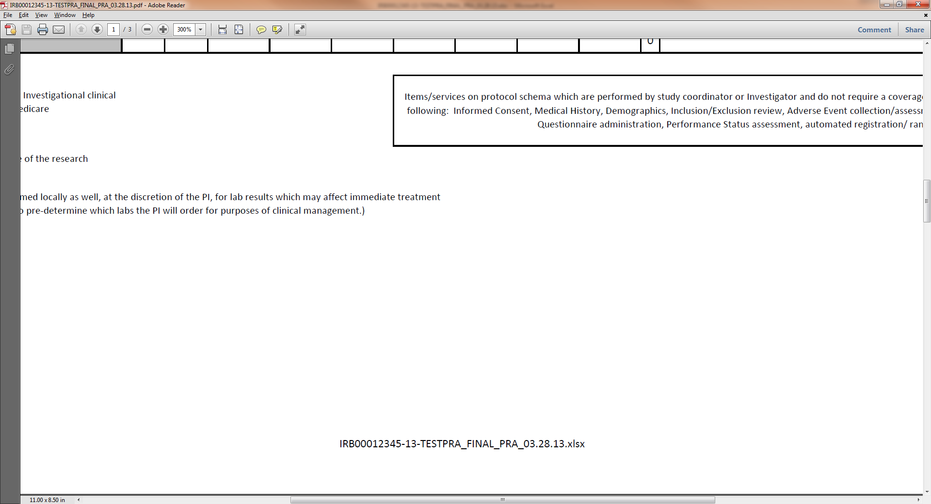
Footer Template

Slide 13
Test of Change #2
Test of Change | What was learned?
Met to review data and agreed standard process. Individual results given. Discussed why errors still occurring and options considered, but no changes to process agreed to at this time. Gave individual results so that each could see where their errors occurred Impressed how important this was down stream to patient safety. | The 1St weeks results showed almost 90% accuracy on each element, however subsequent weeks continued to decline.

Slide 14
Week 3 Data
Sharp Decline in Accuracy

Slide 15
Test of Change #3
Test of Change | What was learned?
Met week 8 to review progress and continued errors. Discussed why errors still occurring. List of error provided to each lead and expectation laid out that corrections would be made and reviewed. Items were placed on the Check list and to be reviewed prior to hand off to SPA. An additional level of QA was set up to be reviewed by SPA when handed off. | Learned there are more scenarios to consider that may not fit the current standards set causing indecision and errors on the report. Some Leads dismayed and concerned - feeling their finished products were correct every time. Learned we did not have to be so precise on some of the guidelines (i.e. all CAPS vs. not)
 | ** We discovered that we as the QA Team did not initially require the Leads to correct the identified with errors, however the data was provided to the individual leads on which errors were found on specific PRAs.

Slide 16
PRA Title Name

Slide 17
Footer Accuracy

Slide 18
QCT Page: Protocol Date

Slide 19
Completed Folder

Slide 20
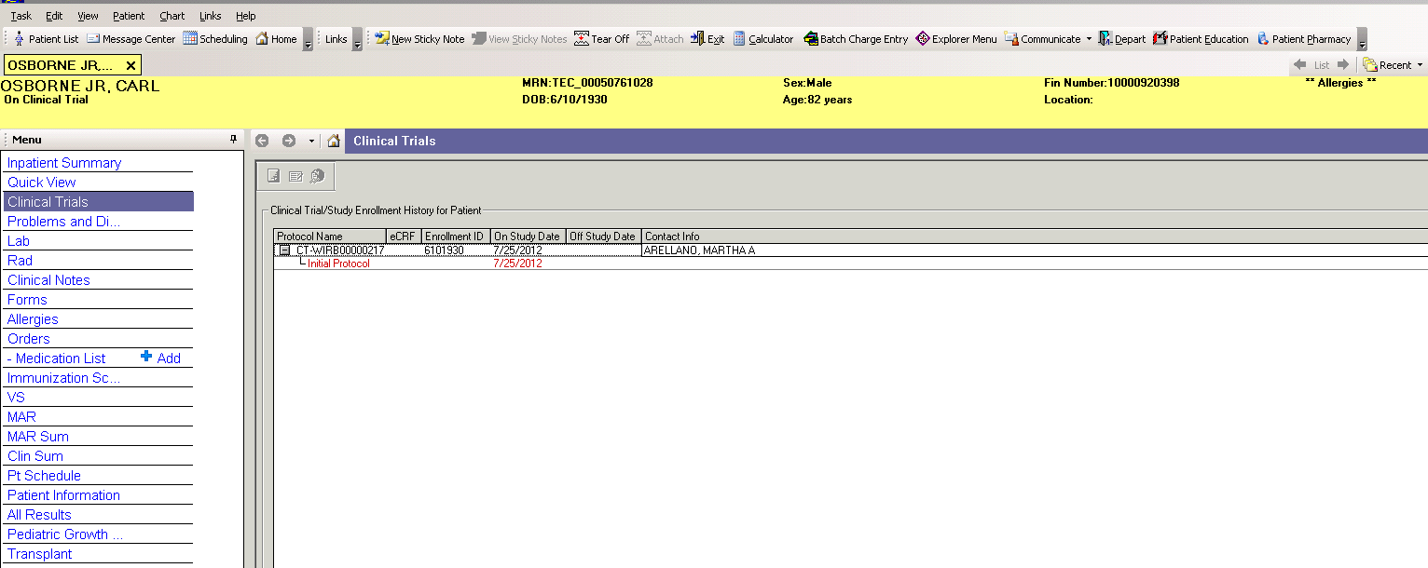
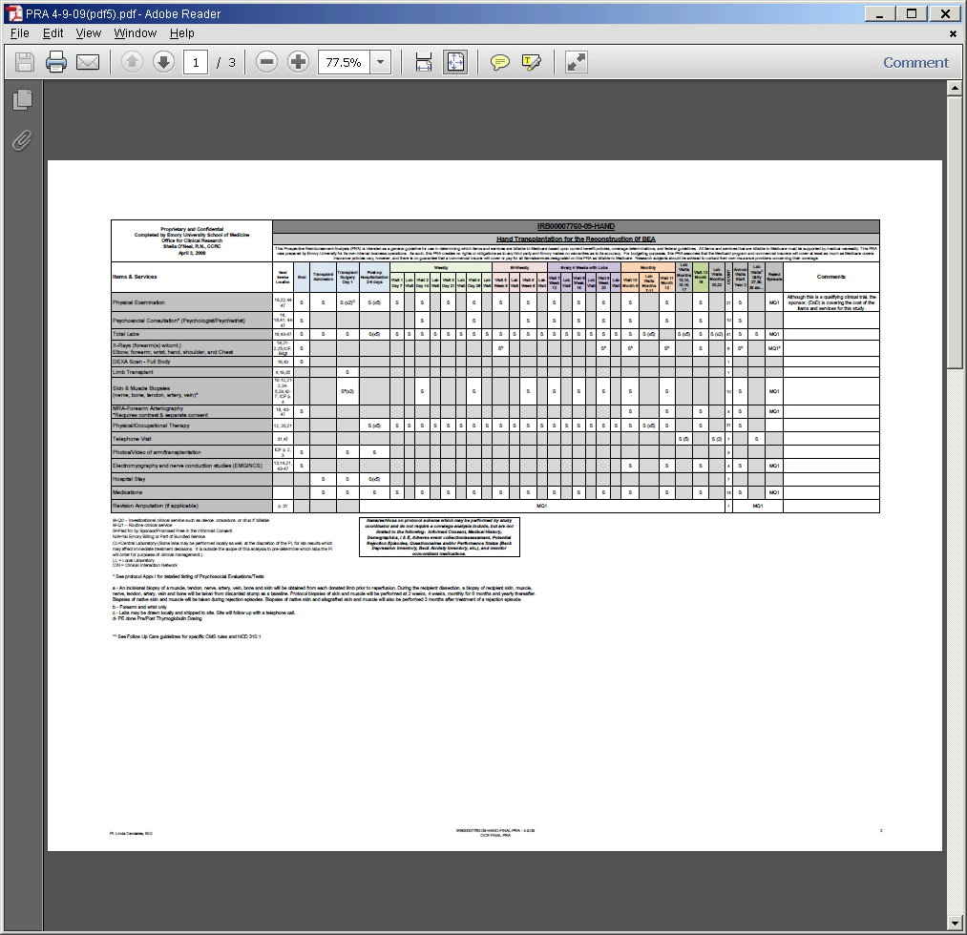
Electronic Medical Record Documentation of Clinical Research
Your patient’s banner will appear with an “On-Clinical Trial” notification if entered in ERMS.
Patient’s name

Slide 21
Barriers
Barriers Encountered | How Overcome
Personality Differences | How to get their buy-in
Didn’t understand why important | Explained how it affects the down stream process in regards to patient safety
Different learning styles and unanticipated confusion of the process | Provided verbal instructions along with printed guidelines, screen shots, template examples and lastly updated our checklist to include this process
Not all protocols use the same date format | Accepted the date Lead uses regardless of format on protocol

Slide 22
Next Steps
Set QA steps in process for monthly review to continue to ensure quality and sustain results.
Involve Sr. Program Associate to review before final hand off to Data Integrity Team.

Slide 23
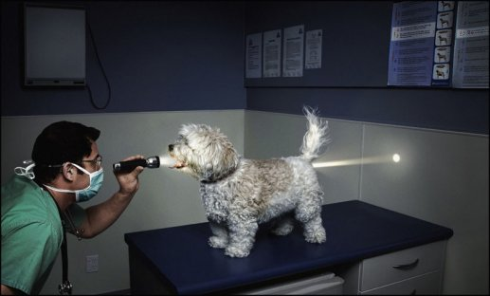
Conclusion
FINALLY THE LIGHT AT THE END OF THE TUNNEL

