Slide 1
Research Upgrade Training Presentation
Epic Version Feb/May 2023
Coming October 2023

Slide 2
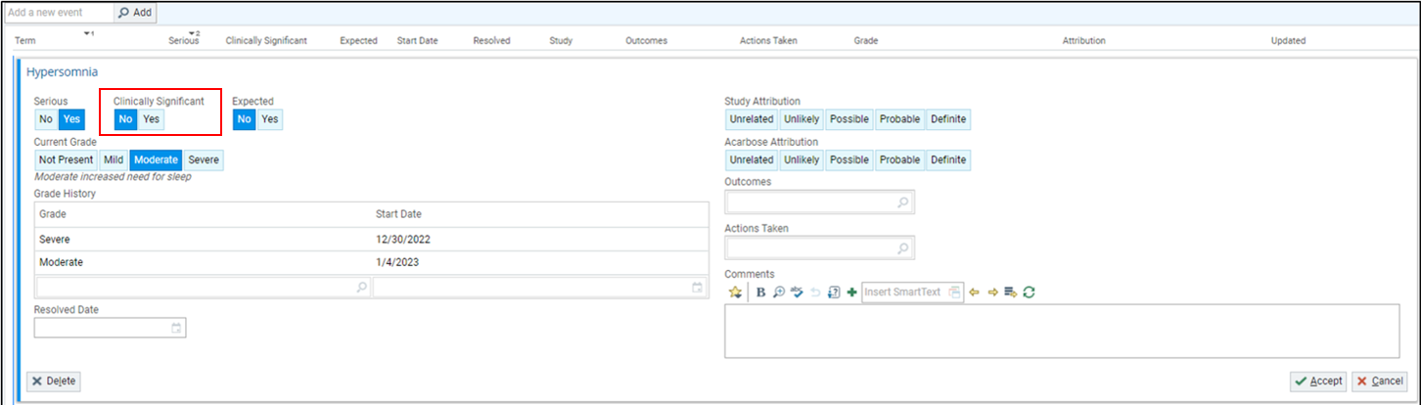
Record Clinical Significance for Adverse Events
For study teams that document Adverse Events in Epic.
To more accurately document adverse events for an ongoing research study, use the Clinically Significant buttons to indicate whether an adverse event is clinically significant.

Slide 3
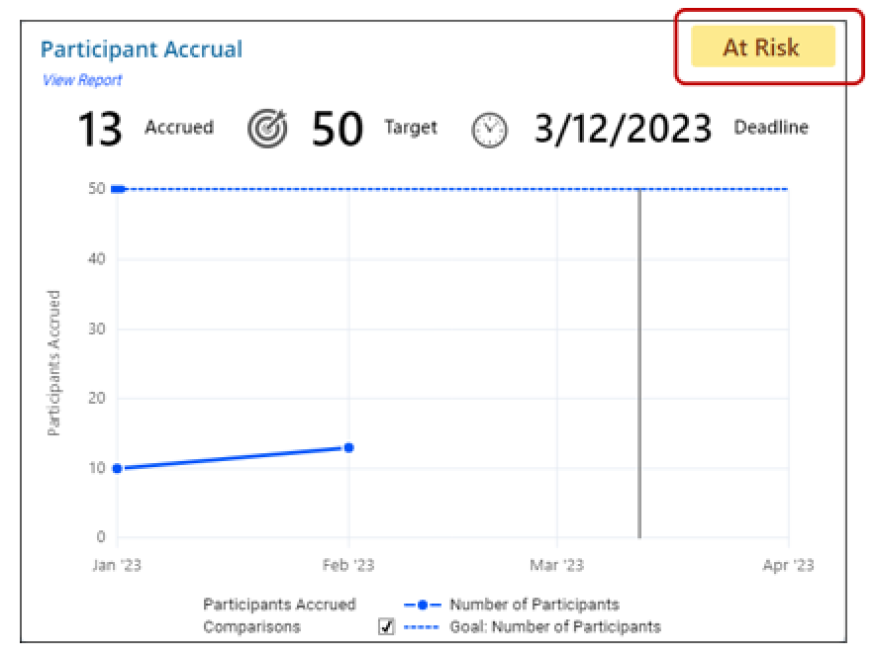
Get a Quick Indicator of How Participant Accrual is Going
The Research Study at a Glance Dashboard has a new badge that gives you a quick indicator of whether you’re on track to meet your target.
Hover over the badge to see a tooltip with information about how the value was calculated.

Slide 4
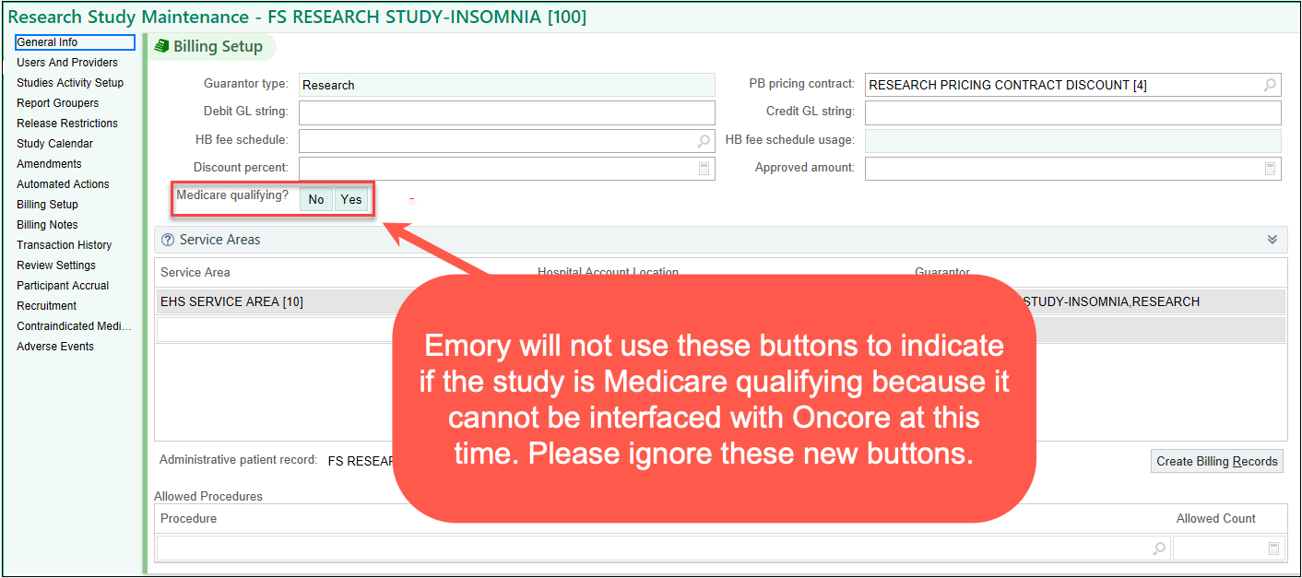
New Medicare Qualifying Buttons in Billing Setup
- Do Not Use -
Buttons have been added to the Billing Setup section of the Research Maintenance activity to track whether research studies are Medicare qualifying clinical trials.
These new buttons are not functional b/c they cannot be interfaced with Oncore.
Please disregard these buttons until further notice.

